Slide 1

DBMS Introduction
Unit - 1

Slide 2
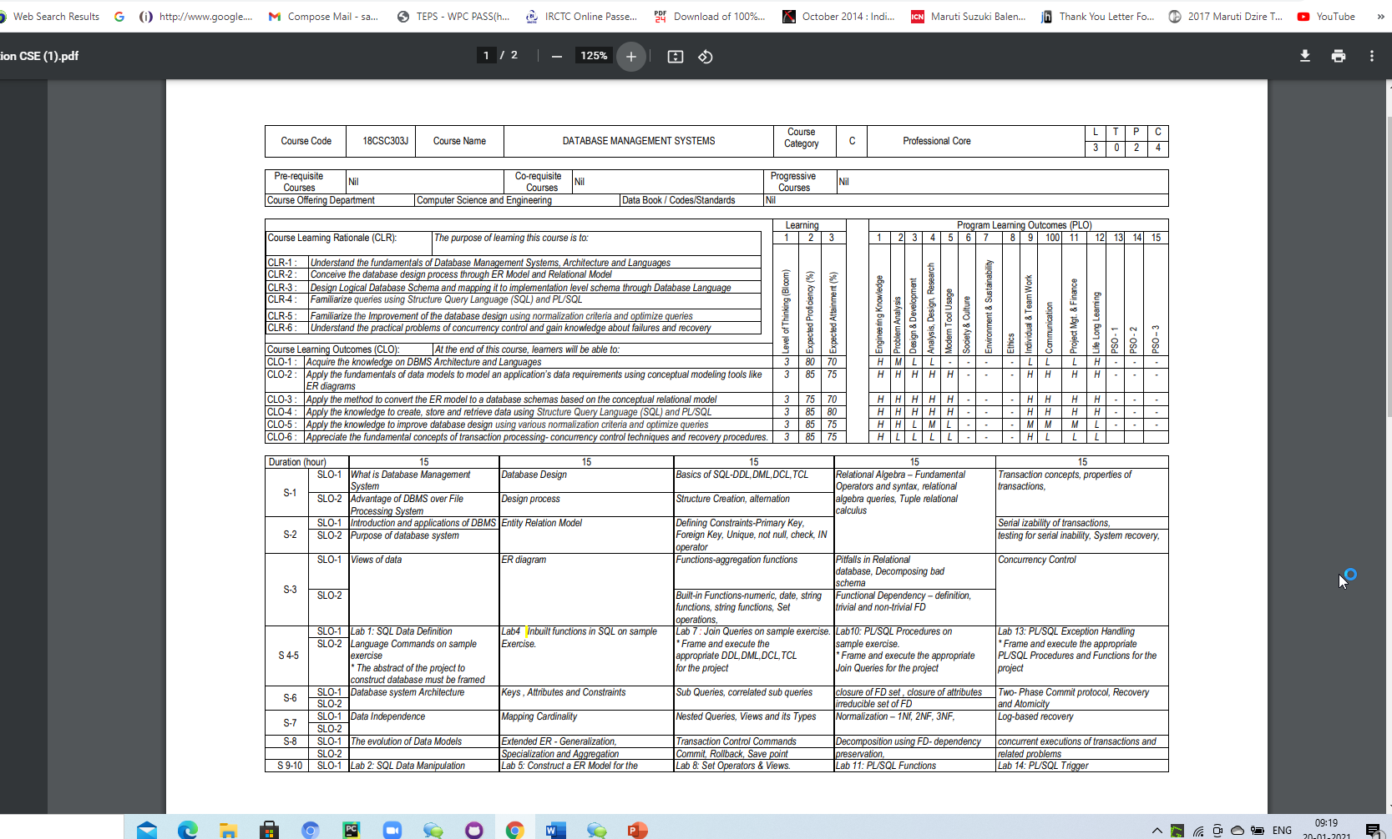

Slide 3
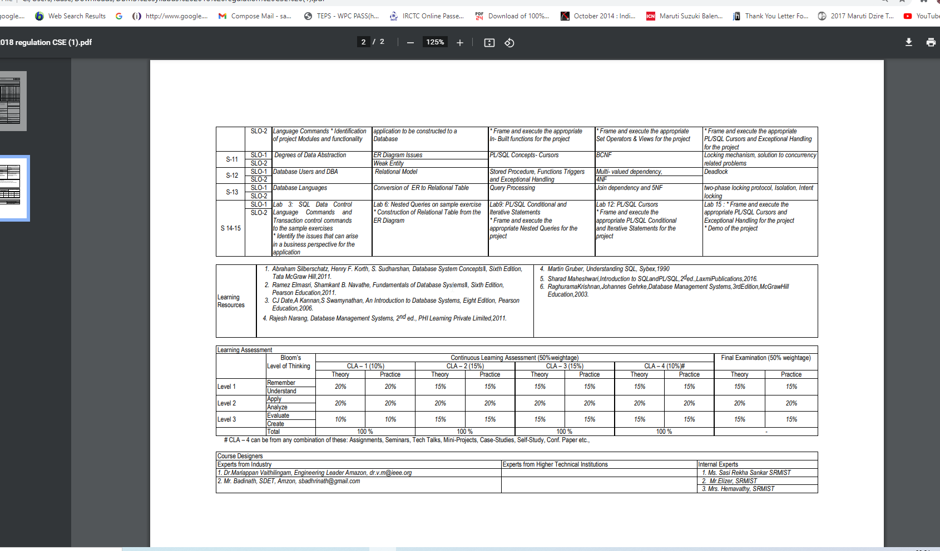

Slide 4
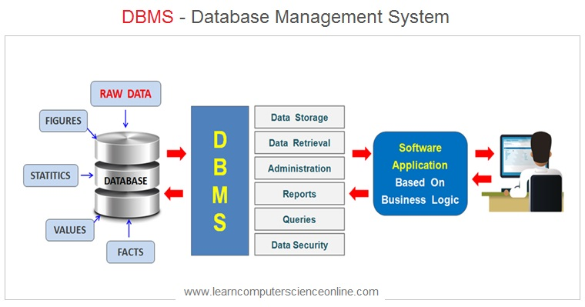
DBMS – Data Base Management System
A database-management system (DBMS) is a collection of interrelated data and a set of programs to access those data.
Database - The collection of data, that contains information relevant to an enterprise.
DBMS is to provide a way to store and retrieve database information.
Importance
Database systems are designed to manage large bodies of information.
Management of data involves both defining structures for storage of information and providing mechanisms for the manipulation of information.
Ensure the safety of the information stored, despite system crashes or attempts at unauthorized access.
If data are to be shared among several users, the system must avoid possible anomalous results.

Slide 5
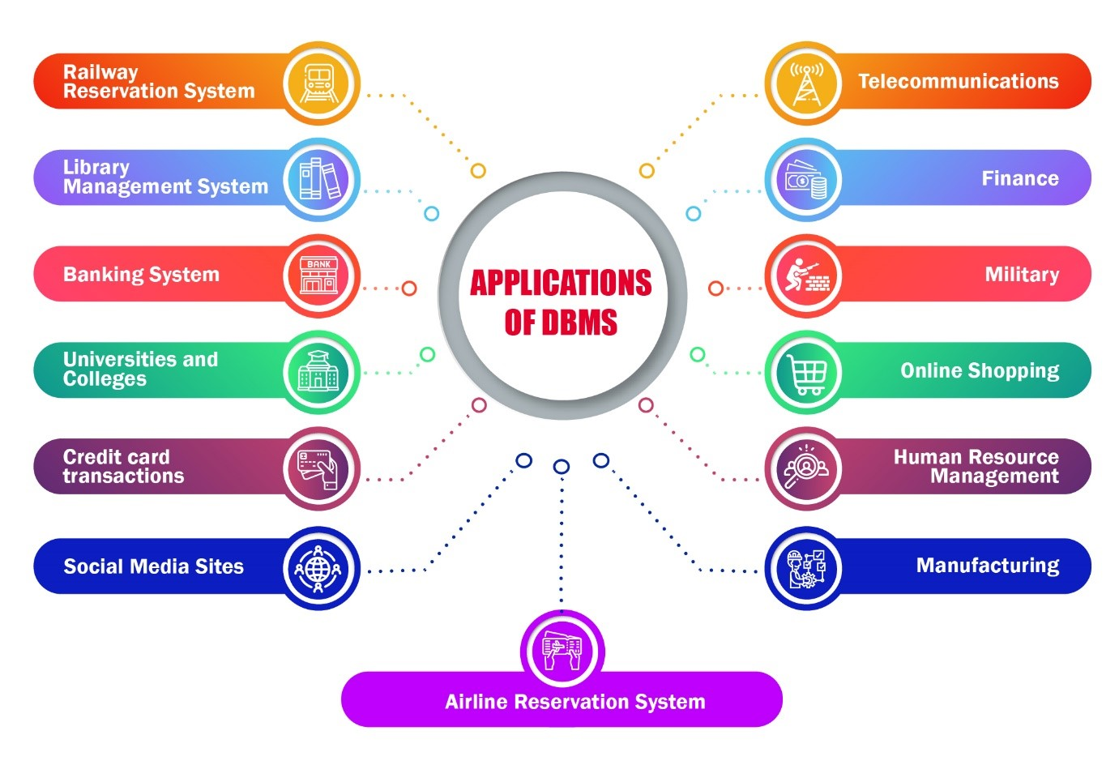
Database-System Applications
Banking: all transactions.
Airlines: reservations, schedules.
Universities: registration, grades.
Sales: customers, products, purchases.
Manufacturing: production, inventory, orders, supply chain.
Human resources: employee records, salaries, tax deductions.
Credit card transactions: Purchase, generation of monthly statements.
Finance: storing information about holdings, sales, and purchases of financial instruments such as stocks and bonds.
Telecommunication: keeping records of calls made, generating monthly bills, maintaining balances on prepaid calling cards, and storing information about the communication networks.

Slide 6
Purpose of Database Systems
File-processing system
Supported by a conventional operating system.
The system stores permanent records in various files, and it needs different application programs to extract records from, and add records to, the appropriate files.
Before database management systems (DBMSs) were introduced, organizations usually stored information in such systems.
Disadvantage
Data redundancy: Multiple file formats, duplication of information in different files.
E.g.: Student has a double major (music and mathematics) the address and telephone number of that student may appear in a file that consists of student records of students in the Music department and in a file that consists of student records of students in the Mathematics department.
This redundancy leads to higher storage and access cost.
Data inconsistency: The various copies of the same data may no longer agree.
E.g.: A changed student address may be reflected in the Music department records but not elsewhere in the system.

Slide 7
Difficulty in accessing data: Need to write a new program to carry out each new task.
Conventional file-processing environments do not allow needed data to be retrieved in a convenient and efficient manner.
More responsive data-retrieval systems are required for general use.
Data isolation: Data are scattered in various files, and files may be in different formats, writing new application programs to retrieve the appropriate data is difficult.
Integrity problems: The data values stored in the database must satisfy certain types of consistency constraints.
E.g.: account balance < 0 (never fall less than zero).
Hard to add new constraints or change existing ones.
Atomicity problems: Failures may leave the database in an inconsistent state with partial updates carried out.
E.g.: Transfer of funds from one account to another should either be complete or not happen at all.
Difficult to ensure atomicity in a conventional file-processing system.

Slide 8
Concurrent-access anomalies: For the sake of overall performance of the system and faster response, many systems allow multiple users to update the data simultaneously.
Uncontrolled concurrent accesses can lead to inconsistencies.
E.g.: Two people reading a balance and updating it at the same time.
Consider department A, with an account balance of $10,000. If two department clerks debit the account balance ($500 and $100) of department A at almost exactly the same time the result of the concurrent executions may leave the budget in an incorrect (or inconsistent) state.
If the two programs run concurrently, they may both read the value $10,000, and write back $9500 and $9900, respectively. Depending on which one writes the value last, the account balance of department A may contain either $9500 or $9900, rather than the correct value of $9400.
Security problems: Not every user of the database system should be able to access all the data.
E.g.: in a university, payroll personnel need to see only that part of the database that has financial information. They do not need access to information about academic records.
Database systems offer solutions to all the above problems

Slide 9
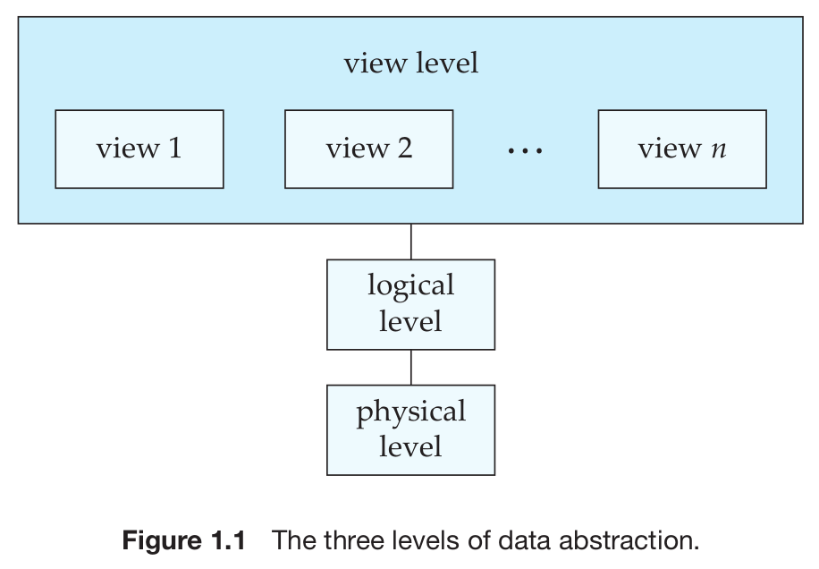
Levels of Data Abstraction
Physical level: The lowest level of abstraction.
Describes how the data are actually stored.
The physical level describes complex low-level data structures in detail.
Logical level: Describes what data are stored in the database, and what relationships exist among those data.
type customer = record name : string; street : string; city : integer; end;
View level: The highest level of abstraction. Describes only part of the entire database. Application programs hide details of data types.
Views can also hide information (e.g., salary) for security purposes.

Slide 10
Instances and Schemas
Instance: The collection of information stored in the database at a particular moment.
Schema: The overall design of the database is called the database schema.
The concept of database schemas and instances can be understood by analogy to a program written in a programming language.
A database schema corresponds to the variable declarations (along with associated type definitions) in a program.
The values of the variables in a program at a point in time correspond to an instance of a database schema.
Physical schema: Describes the database design at the physical level.
Logical schema: Describes the database design at the logical level.
Subschemas: A database may also have several schemas at the view level.
Physical Data Independence: The ability to modify the physical schema without changing the logical schema.
Applications depend on the logical schema.
In general, the interfaces between the various levels and components should be well defined so that changes in some parts do not seriously influence others.

Slide 11
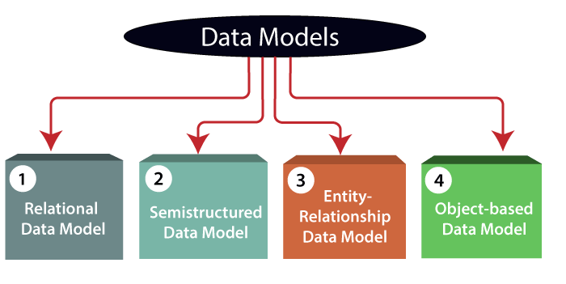
Data Models
A collection of conceptual tools for describing data, data relationships, data semantics, and consistency constraints.
A data model provides a way to describe the design of a database at the physical, logical, and view levels.
Relational Model: The relational model uses a collection of tables to represent both data and the relationships among those data.
Each table has multiple columns, and each column has a unique name.
Tables are also known as relations. The relational model is an example of a record-based model.
Entity-Relationship Model: The entity-relationship (E-R) data model uses a collection of basic objects, called entities, and relationships among these objects.
The entity-relationship model is widely used in database design.

Slide 12
Object-Based Data Model: The development of an object-oriented data model that can be seen as extending the E-R model with notions of encapsulation, methods (functions), and object identity.
The object-relational data model combines features of the object-oriented data model and relational data model.
Semi structured Data Model: The semi structured data model permits the specification of data where individual data items of the same type may have different sets of attributes.
The Extensible Markup Language (XML) is widely used to represent semi structured data.
The network data model and the hierarchical data model preceded the relational data model.

Slide 13
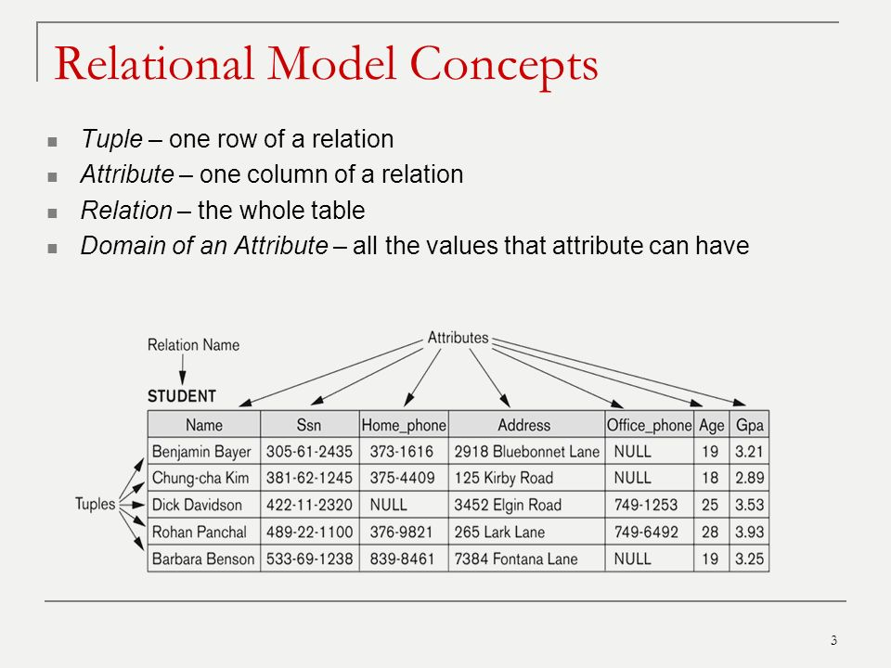
Relational Model
Tuple – one row of a relation
Attribute – one column of a relation
Relation – the whole table
Domain of an attribute – all the values that the attribute

Slide 14
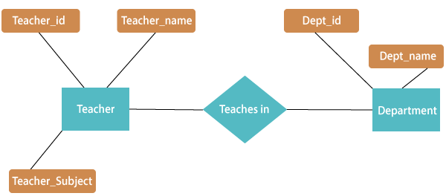
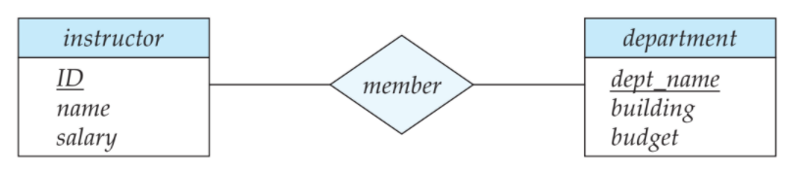
Entity-Relationship Model
E-R model of real world
Entities (objects)
E.g. Teacher, Department.
Relationships between entities
Relationship set teaches in associates teacher with department.
Widely used for database design.
Entity sets are represented by a rectangular box with the entity set name in the header and the attributes listed below it.
Relationship sets are represented by a diamond connecting a pair of related entity sets.
The name of the relationship is placed inside the diamond.
Mapping cardinalities: The number of entities to which another entity can be associated via a relationship set.

Slide 15
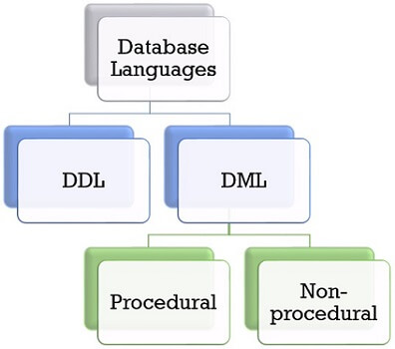
Database Languages
A database system provides a Data-Definition Language (DDL) to specify the database schema and a Data-Manipulation Language (DML) to express database queries and updates.
Data-Manipulation Language (DML)
A data-manipulation language (DML) is a language that enables users to access or manipulate data as organized by the appropriate data model.
The types of access are
Retrieval of information stored in the database
Insertion of new information into the database
Deletion of information from the database
Modification of information stored in the database
Procedural DMLs require a user to specify what data are needed and how to get those data.
Declarative DMLs (also called as nonprocedural DMLs) require a user to specify what data are needed without specifying how to get those data.
A query is a statement requesting the retrieval of information. The portion of a DML that involves information retrieval is called a query language.

Slide 16
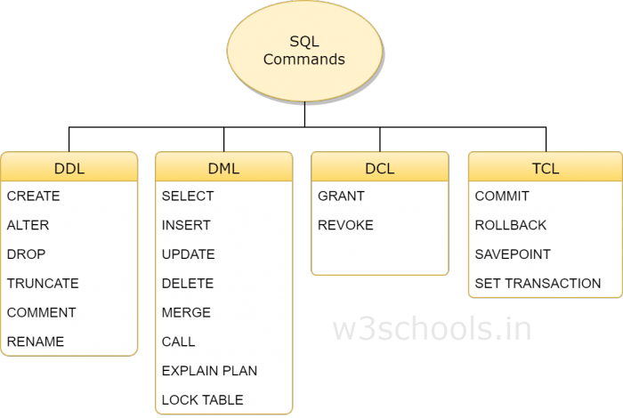
Database Languages
DDL is Data Definition Language statements
Some examples
CREATE - to create objects in the database
ALTER - alters the structure of the database
DROP - delete objects from the database
TRUNCATE - remove all records from a table
COMMENT - add comments to the data dictionary

Slide 17
DML is Data Manipulation Language statements
Some examples:
SELECT - retrieve data from the a database
INSERT - insert data into a table
UPDATE - updates existing data within a table
DELETE - deletes all records from a table, the space for the records remain
CALL - call a PL/SQL or Java subprogram
EXPLAIN PLAN - explain access path to data
LOCK TABLE - control concurrency

Slide 18
TCL(Transaction Control Language) is a DML
COMMIT - save work done
SAVEPOINT - identify a point in a transaction to which you can later roll back
ROLLBACK - restore database to original since the last COMMIT
SET TRANSACTION - Change transaction options like what rollback segment to use
DCL is Data Control Language statements
Some examples:
GRANT - gives user's access privileges to database
REVOKE - withdraw access privileges given with the GRANT command

Slide 19
Data-Definition Language
Set of definitions expressed by a special language called a data-definition language (DDL).
The storage structure and access methods used by the database system by a set of statements in a special type of DDL called a data storage and definition language.
The data values stored in the database must satisfy certain consistency constraints.
Domain Constraints: A domain of possible values must be associated with every attribute (for example, integer types, character types, date/time types).
Domain constraints are the most elementary form of integrity constraint.
Referential Integrity: There are cases where we wish to ensure that a value that appears in one relation for a given set of attributes also appears in a certain set of attributes in another relation (referential integrity).
Database modifications can cause violations of referential integrity.
Assertions: An assertion is any condition that the database must always satisfy. Domain constraints and referential-integrity constraints are special forms of assertions.
Authorization: To differentiate among the users as far as the type of access they are permitted on various data values in the database. These differentiations are expressed in terms of authorization.

Slide 20
Read Authorization - which allows reading, but not modification of data.
Insert Authorization - which allows insertion of new data but not modification of existing data.
update authorization - which allows modification but not deletion of data.
Delete Authorization - which allows deletion of data.
The output of the DDL is placed in the data dictionary which contains metadata - that is, data about data.
SQL provides a rich DDL that allows one to define tables, integrity constraints, assertions, etc.
create table department (dept name char (20), building char (15), budget numeric (12,2));
Execution of the above DDL statement creates the department table with three columns: dept name, building, and budget, each of which has a specific data type associated with it.

Slide 21
CREATING DATABASE TABLE
CREATE – creates a new table in the database
Used to create a table by defining its structure, the data type and name of the various columns, the relationships with columns of other tables etc.
CREATE TABLE table_name (column_name1 data_type(size), column_name2 data_type(size),…., column_nameN data_type(size));
E.g.:
CREATE TABLE Employee(Name varchar2(20), DOB date, Salary number(6));

Slide 22
ALTER - Add a new attribute or Modify the characteristics of some existing attribute.
ALTER TABLE table_name ADD (column_name1 data_type (size), column_name2 data_type (size),….., column_nameN data_type (size));
E.g.:
ALTER TABLE Employee ADD (Address varchar2(20));
ALTER TABLE Employee ADD (Designation varchar2(20), Dept varchar2(3));

Slide 23
ALTER TABLE table_name MODIFY (column_name data_type(new_size));
E.g.:
ALTER TABLE Employee MODIFY (Name varchar2(30));
ALTER - dropping a column from the table
ALTER TABLE table_name DROP COLUMN column_name;
E.g.:
ALTER TABLE Student DROP COLUMN Age;

Slide 24
DROP - Deleting an entire table from the database.
DROP TABLE table_name;
E.g.:
DROP TABLE Employee
RENAME – Renaming the table
RENAME old_table_name TO new_table_name;
E.g.:
RENAME Employee TO Employee_details

Slide 25
TRUNCATE – deleting all rows from a table and free the space containing the table.
TRUNCATE TABLE table_name;
E.g.:
TRUNCATE TABLE Employee_details;

Slide 26
Data Manipulation Language
A DML statement is executed when you
Add new rows to a table
Modify existing rows in a table
Remove existing rows from a table

Slide 27
Add new rows to a table by using the INSERT statement.
1. INSERT INTO table VALUES(value1, value2,..);
Only one row is inserted at a time with this syntax.
List values in the default order of the columns in the table
Enclose character and date values within single quotation marks.
Insert a new row containing values for each column.
E.g.:
INSERT INTO Employee VALUES (‘ashok’, ‘16-mar-1998’, 30000);
2. INSERT INTO table(column1, column2,..)VALUES(value1, value2,..);
Rows can be inserted with NULL values either
by omitting column from the column list or
by specifying NULL in the value field.
E.g.:
INSERT INTO Employee (name, dob, salary) VALUES (‘ashok’, ‘16-mar-1998’, 30000);

Slide 28
3. INSERT INTO table_name1 SELECT column_name1, column_name2,….,column_nameN FROM table_name2;
INSERT INTO Employee_details SELECT name, dob FROM Exmployee;

Slide 29
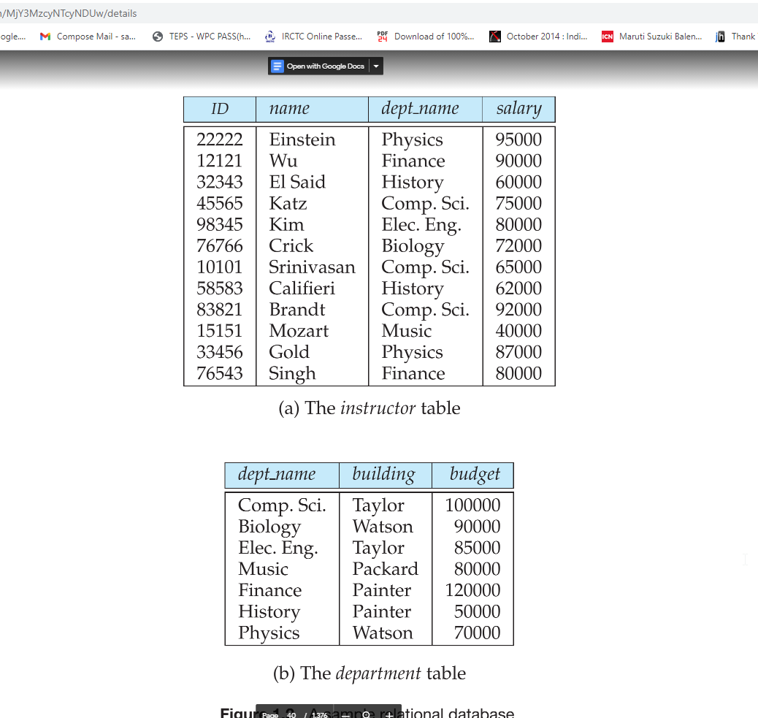
Data-Manipulation Language (DML)
The SQL query language is nonprocedural.
select instructor.name from instructor where instructor.dept name = ’History’;
Queries may involve information from more than one table.
select instructor.ID, department.dept name from instructor, department where instructor.dept name= department.dept name and department.budget > 95000;

Slide 30
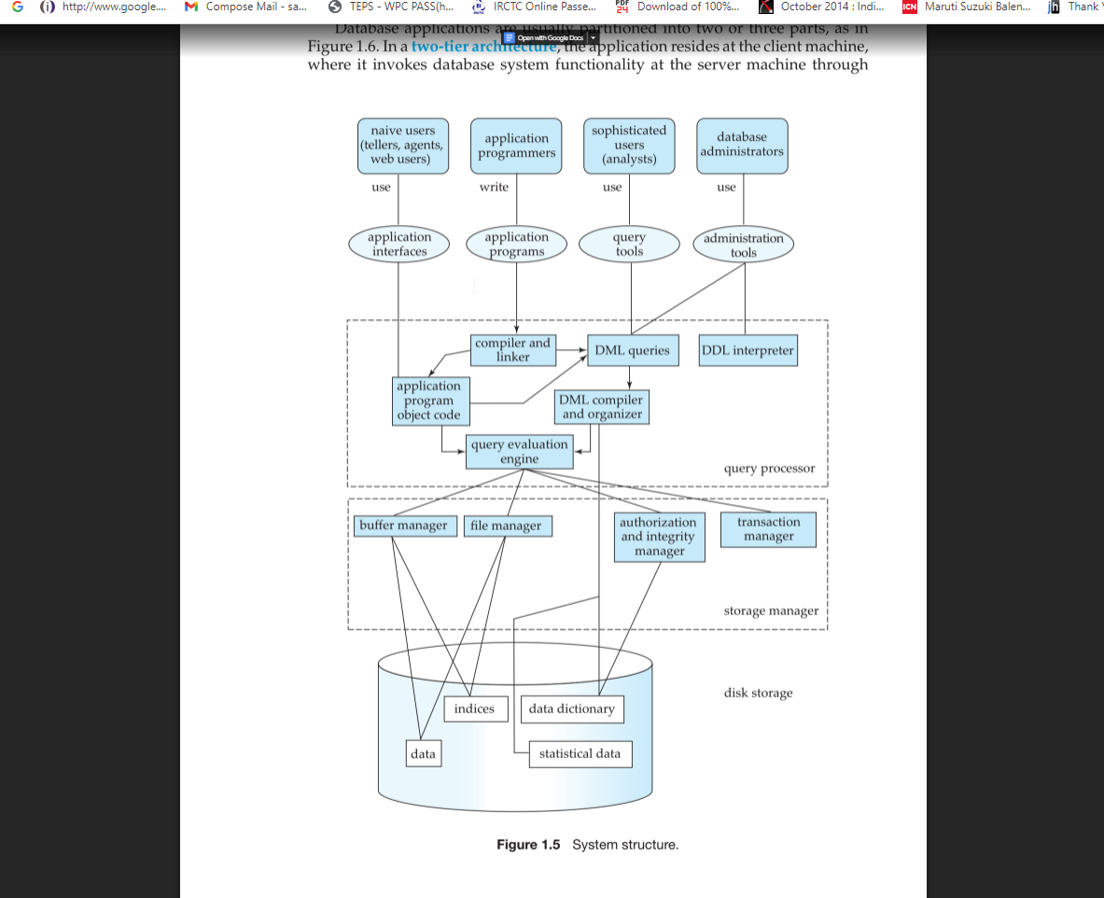
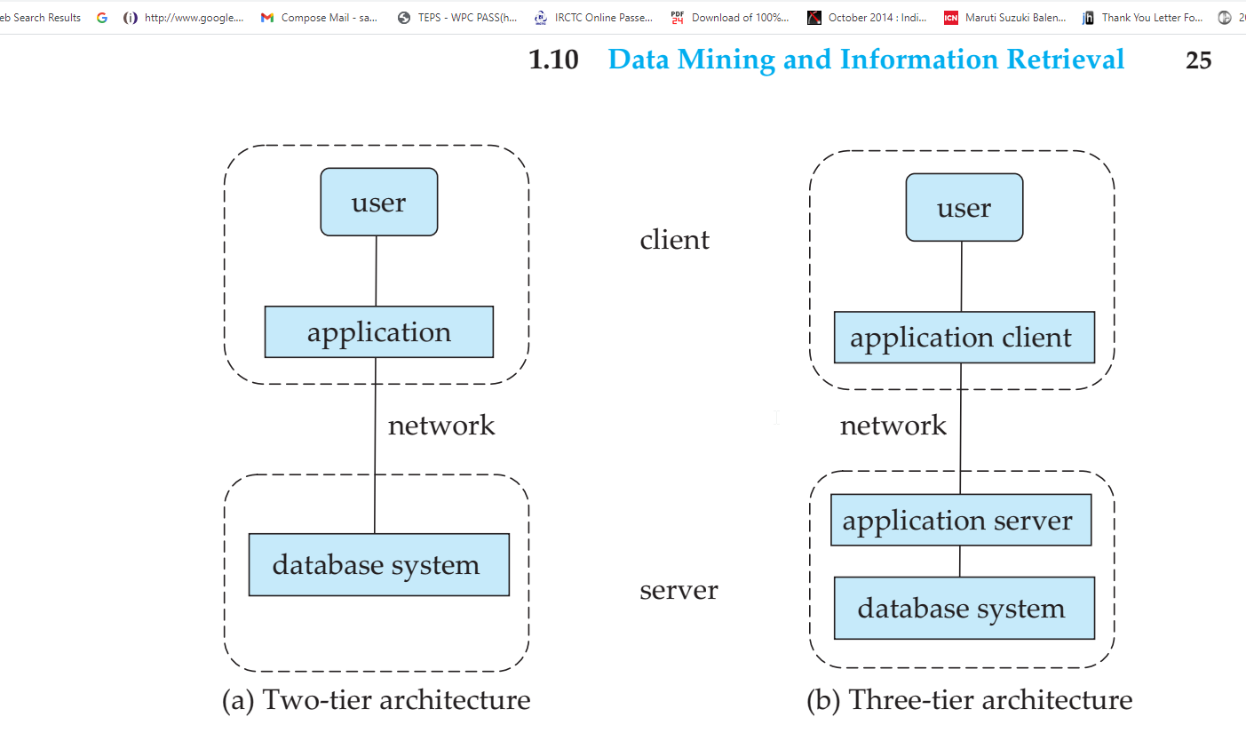
Database Architecture
Database applications are usually partitioned into two or three parts.
In a two-tier architecture, the application resides at the client machine, where it invokes database system functionality at the server machine through query language statements.
Three-tier architecture - the client machine acts as merely a front end and does not contain any direct database calls.

Slide 31
Database Users
Users are differentiated by the way they expect to interact with the system
Naive users: unsophisticated users who interact with the system by invoking one of the application programs that have been written previously.
Application programmers: computer professionals who write application programs. Application programmers can choose from many tools to develop user interfaces.
Sophisticated users: interact with the system without writing programs.
Specialized users: sophisticated users who write specialized database applications that do not fit into the traditional data-processing framework.

Slide 32
Database Administrator
One of the main reasons for using DBMSs is to have central control of both the data and the programs that access those data.
-A person who has such central control over the system is called a database administrator (DBA).
Schema definition: The DBA creates the original database schema by executing a set of data definition statements in the DDL.
Storage structure and access-method definition.
Schema and physical-organization modification: The DBA carries out changes to the schema and physical organization to reflect the changing needs of the organization, or to alter the physical organization to improve performance.
Granting of authorization for data access: By granting different types of authorization, the database administrator can regulate which parts of the database various users can access.
Routine maintenance: Periodically backing up the database, Ensuring that enough free disk space, Monitoring jobs running on the database.

Slide 33
Transaction Management
Atomicity - all-or-none requirement.
one department account (A) is debited and another department account (B) is credited.
Either both the credit and debit occur, or that neither occur.
Consistency - it is essential that the execution of the funds transfer preserve the consistency of the database. The value of the sum of the balances of A and B must be preserved.
-This is called correctness requirement.
Durability - After the successful execution of a funds transfer, the new values of the balances of accounts A and B must persist, despite the possibility of system failure.
-This is called persistence requirement.

Slide 34
Storage Manager
The storage manager is the component of a database system that provides the interface between the low-level data stored in the database and the application programs and queries submitted to the system.
The storage manager is responsible for the interaction with the file manager.
The storage manager components include
Authorization and integrity manager: which tests for the satisfaction of integrity constraints and checks the authority of users to access data.
Transaction manager: which ensures that the database remains in a consistent (correct) state despite system failures, and that concurrent transaction executions proceed without conflicting.
File manager: which manages the allocation of space on disk storage and the data structures used to represent information stored on disk.
Buffer manager: which is responsible for fetching data from disk storage into main memory, and deciding what data to cache in main memory.
The buffer manager is a critical part of the database system, since it enables the database to handle data sizes that are much larger than the size of main memory.

Slide 35
The storage manager implements several data structures as part of the physical system implementation
Data files: which store the database itself.
Data dictionary: which stores metadata about the structure of the database, in particular the schema of the database.
Indices: which can provide fast access to data items.
Like the index in this textbook, a database index provides pointers to those data items that hold a particular value.
The Query Processor
The query processor components include
DDL interpreter: which interprets DDL statements and records the definitions in the data dictionary.
DML compiler: which translates DML statements in a query language into an evaluation plan consisting of low-level instructions that the query evaluation engine understands.
A query can usually be translated into any of a number of alternative evaluation plans that all give the same result. The DML compiler also performs query optimization; that is, it picks the lowest cost evaluation plan from among the alternatives.
Query evaluation engine: which executes low-level instructions generated by the DML compiler.

Slide 36
Evolution of Data Models
A collection of tools for describing
Data
Data relationships
Data semantics
Data constraints
Relational model
Entity-Relationship data model (mainly for database design)
Object-based data models (Object-oriented and Object-relational)
Semi structured data model (XML)
Other older models:
Network model
Hierarchical model
Notes:
36

Slide 37
Evolution of Data Models
Several criteria can be used to classify DBMSs.
The first is the data model on
which the DBMS is based. The main data model used in many current commercial DBMSs is the relational data model, and the systems based on this model are known as SQL systems.
The object data model has been implemented in some commercial systems but has not had widespread use.
Recently, so-called big data systems, also known as key-value storage systems and NOSQL systems, use various
data models: document-based, graph-based, column-based, and key-value
data models.
Many legacy applications still run on database systems based on the
hierarchical and network data models.

Slide 38
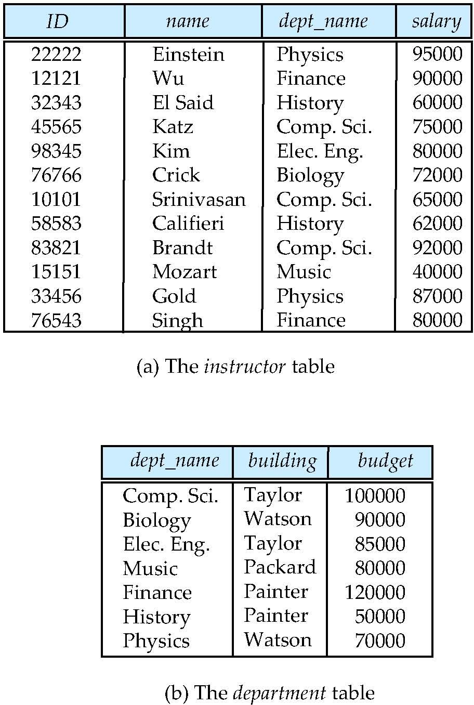
Relational Model
All the data is stored in various tables.
Example of tabular data in the relational model
Columns
Rows
Notes:
38

Slide 39
A Sample Relational Database
Notes:
39

Slide 40
DATABASE LANGUAGES
A database system provides a Data-Definition Language (DDL) to specify the database schema and a Data-Manipulation Language (DML) to express database queries and updates.
Data-Manipulation Language (DML)
A data-manipulation language (DML) is a language that enables users to access or manipulate data as organized by the appropriate data model.
The types of access are
• Retrieval of information stored in the database
• Insertion of new information into the database
• Deletion of information from the database
• Modification of information stored in the database

Slide 41
Data Definition Language (DDL)
Specification notation for defining the database schema
Example: create table instructor ( ID char(5), name varchar(20), dept_name varchar(20), salary numeric(8,2))
DDL compiler generates a set of table templates stored in a data dictionary
Data dictionary contains metadata (i.e., data about data)
Database schema
Integrity constraints
Primary key (ID uniquely identifies instructors)
Authorization
Who can access what
Notes:
41

Slide 42
Data Manipulation Language (DML)
Language for accessing and manipulating the data organized by the appropriate data model
DML also known as query language
Two classes of languages
Pure – used for proving properties about computational power and for optimization
Relational Algebra
Tuple relational calculus
Domain relational calculus
Commercial – used in commercial systems
SQL is the most widely used commercial language
Notes:
42

Slide 43
SQL
The most widely used commercial language
SQL is NOT a Turing machine equivalent language
To be able to compute complex functions SQL is usually embedded in some higher-level language
Application programs generally access databases through one of
Language extensions to allow embedded SQL
Application program interface (e.g., ODBC/JDBC) which allow SQL queries to be sent to a database
Notes:
43

Slide 44
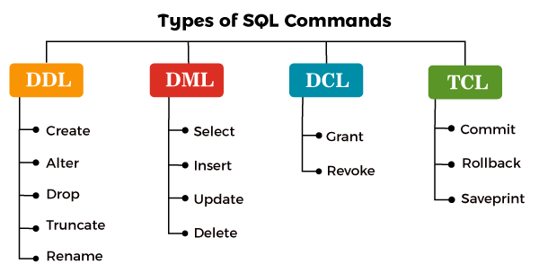

Slide 45
DML Commands
Command | Explanation
Select | The SELECT operation is used for selecting a subset of the tuples according to a given selection condition
Projection | The projection eliminates all attributes of the input relation but those mentioned in the projection list.
Union | UNION is symbolized by symbol. It includes all tuples that are in tables A or in B.
Intersection | Intersection defines a relation consisting of a set of all tuple that are in both A and B.
Cartesian Product | Cartesian operation is helpful to merge columns from two relations.
Inner Join | Inner join, includes only those tuples that satisfy the matching criteria.
Outer Join | In an outer join, along with tuples that satisfy the matching criteria.

Slide 46
UNION Operator
UNION operator is used to combine the result sets of 2 or more SELECT statements. It removes duplicate rows between the various SELECT statements.
Each SELECT statement statement within the UNION operator must have the same number of fields in the result sets with similar data types.
There must be same number of expressions in both SELECT statements.
Since the UNION operator by default removes all duplicate rows from the result set, providing the UNION DISTINCT modifier has no effect on the results.
The column names from the first SELECT statement in the UNION operator are used as the column names for the result set.
SELECT expression1, expression2, ... expression_n FROM tables [WHERE conditions] UNION SELECT expression1, expression2, ... expression_n FROM tables [WHERE conditions];
SELECT department_id FROM departments UNION SELECT department_id FROM employees;

Slide 47
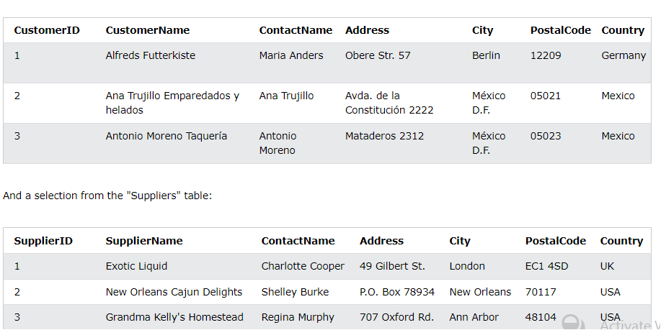
SELECT City FROM Customers UNION SELECT City FROM Suppliers ORDER BY City;
Try it Yourself
SELECT City FROM Customers UNION ALL SELECT City FROM Suppliers ORDER BY City;
Try it Yourself

Slide 48
INTERSECT Operator
The SQLite INTERSECT operator returns the intersection of 2 or more datasets. Each dataset is defined by a SELECT statement.
If a record exists in both data sets, it will be included in the INTERSECT results.
If a record exists in one data set and not in the other, it will be omitted from the INTERSECT results.
There must be same number of expressions in both SELECT statements.
The corresponding expressions must have the same data type in the SELECT statements. For example: expression1 must be the same data type in both the first and second SELECT statement.
Example - With Single Expression
WHERE conditions to the INTERSECT query
SELECT expression1, expression2, ... expression_n FROM tables [WHERE conditions] INTERSECT SELECT expression1, expression2, ... expression_n FROM tables [WHERE conditions];
SELECT department_id FROM departments INTERSECT SELECT department_id FROM employees;
SELECT department_id FROM departments WHERE department_id >= 25 INTERSECT SELECT department_id FROM employees WHERE last_name = 'Anderson';

Slide 49
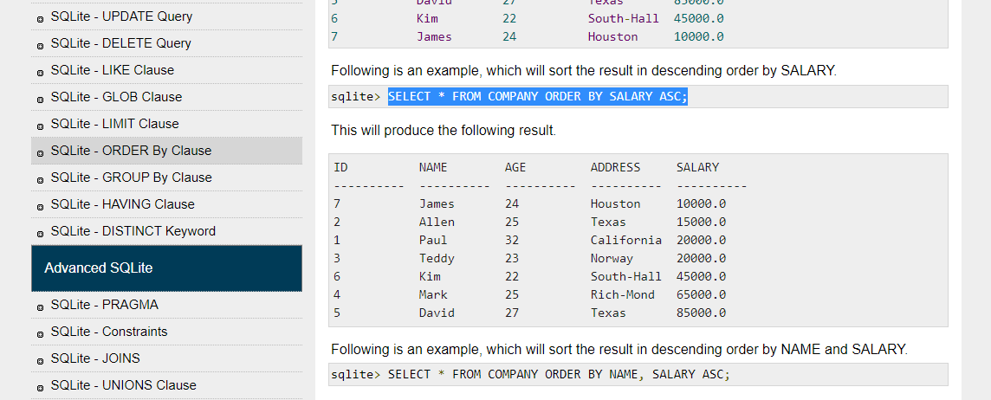
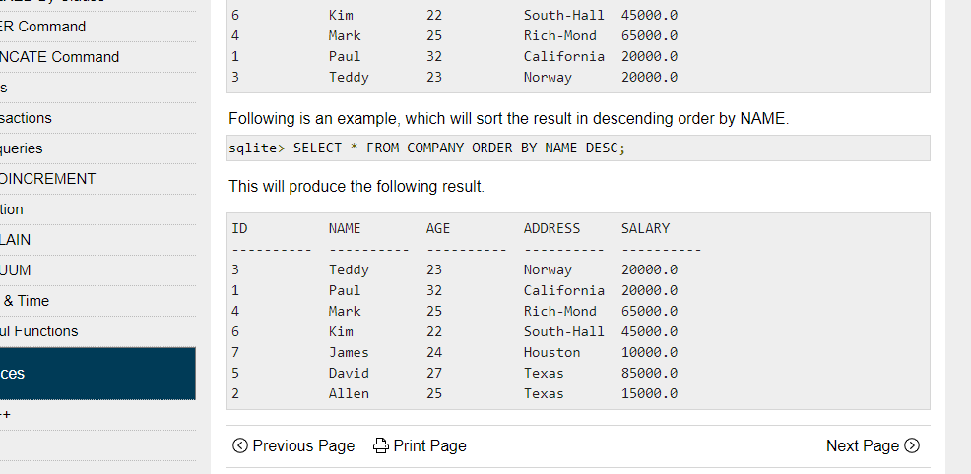
Example - With Multiple Expressions
ORDER BY clause is used to sort the data in an ascending or descending order, based on one or more columns.
SELECT contact_id, last_name, first_name FROM contacts WHERE contact_id > 50 INTERSECT SELECT customer_id, last_name, first_name FROM customers WHERE last_name <> 'Peterson';
SELECT column-list FROM table_name [WHERE condition] [ORDER BY column1, column2, .. columnN] [ASC | DESC];
SELECT * FROM COMPANY ORDER BY SALARY ASC;
SELECT * FROM COMPANY ORDER BY NAME DESC

Slide 50
2. Group By : Group by statement is used to group the rows that have the same value.
It is often used with aggregate functions for example:
AVG(), MAX(), COUNT(), MIN() etc.
One thing to remember about the group by clause is that the tuples are
grouped based on the similarity between the attribute values of tuples.
Group By Syntax –
SELECT function_Name(column_1), column_2 FROM Table_Name
WHERE condition GROUP BY column_1,
column_2 ORDER BY column_1, column_2;

Slide 51
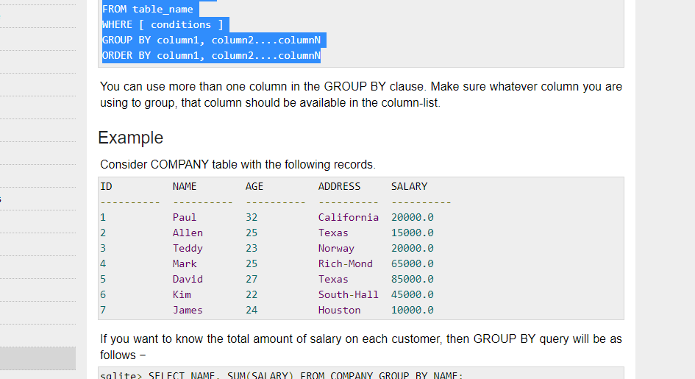
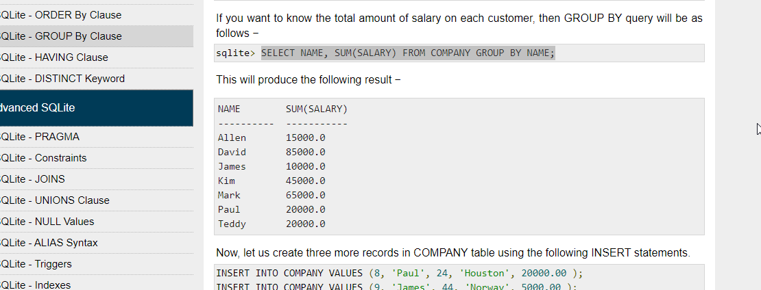
GROUP BY clause is used in collaboration with the SELECT statement to arrange identical data into groups.
GROUP BY clause follows the WHERE clause in a SELECT statement and precedes the ORDER BY clause.
SELECT column-list FROM table_name WHERE [ conditions ] GROUP BY column1, column2....columnN ORDER BY column1, column2....columnN
SELECT NAME, SUM(SALARY) FROM COMPANY GROUP BY NAME;

Slide 52
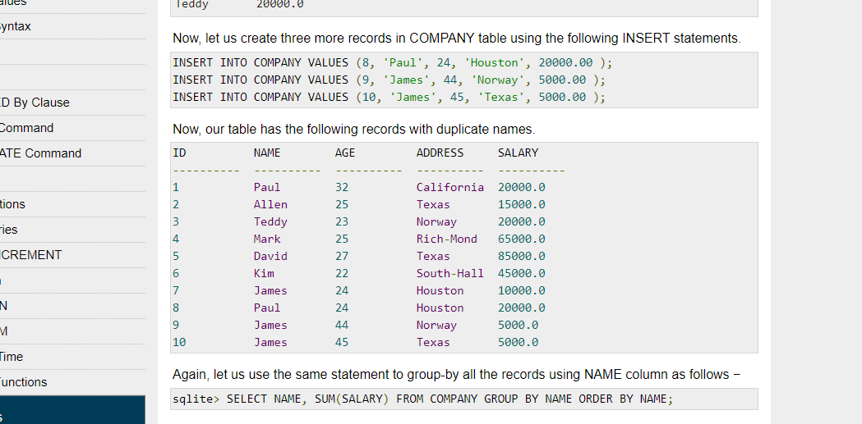
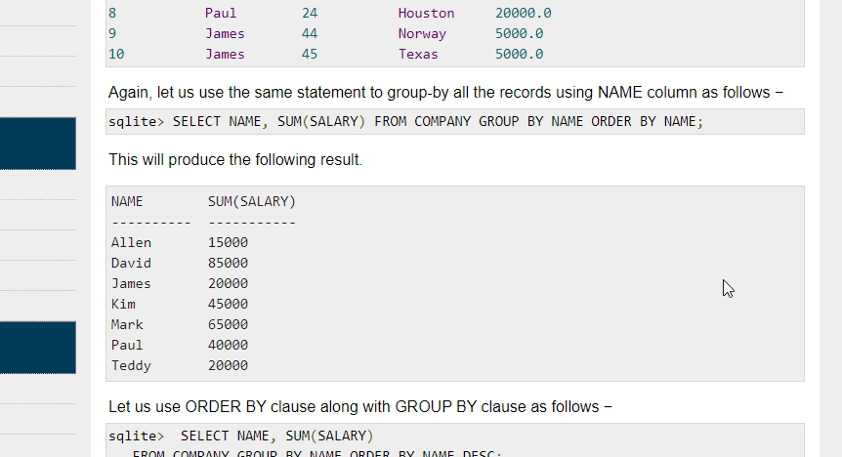
SELECT NAME, SUM(SALARY) FROM COMPANY GROUP BY NAME ORDER BY NAME;

Slide 53
To get data of 'agent_code' and the sum of 'advance_amount' for each individual 'agent_code' from the 'orders' table with the following condition - same 'agent_code' should not come twice,
SELECT agent_code, SUM(advance_amount)
FROM orders
GROUP BY agent_code;
Output:
AGENT_CODE SUM(ADVANCE_AMOUNT)
---------- -------------------
A004 2100
A002 3500
A007 500
A009 100
A011 900
A012 450
A010 3700
A013 3200
A001 200
A008 3300
A006 600
A005 3100
A003 1000

Slide 54
ORD_NUM ORD_AMOUNT ADVANCE_AMOUNT ORD_DATE CUST_CODE AGENT_CODE ORD_DESCRIPTION
---------- ---------- -------------- --------- --------------- --------------- -----------------
200114 3500 2000 15-AUG-08 C00002 A008
200122 2500 400 16-SEP-08 C00003 A004
200118 500 100 20-JUL-08 C00023 A006
200119 4000 700 16-SEP-08 C00007 A010
200121 1500 600 23-SEP-08 C00008 A004
200130 2500 400 30-JUL-08 C00025 A011
200134 4200 1800 25-SEP-08 C00004 A005
200108 4000 600 15-FEB-08 C00008 A004
200103 1500 700 15-MAY-08 C00021 A005
200105 2500 500 18-JUL-08 C00025 A011
200120 500 100 20-JUL-08 C00009 A002
200116 500 100 13-JUL-08 C00010 A009
200124 500 100 20-JUN-08 C00017 A007
200126 500 100 24-JUN-08 C00022 A002
200129 2500 500 20-JUL-08 C00024 A006
200127 2500 400 20-JUL-08 C00015 A003
200128 3500 1500 20-JUL-08 C00009 A002
200135 2000 800 16-SEP-08 C00007 A010
200131 900 150 26-AUG-08 C00012 A012
200133 1200 400 29-JUN-08 C00009 A002
200100 1000 600 08-JAN-08 C00015 A003
200110 3000 500 15-APR-08 C00019 A010
200107 4500 900 30-AUG-08 C00007 A010
200112 2000 400 30-MAY-08 C00016 A007
200113 4000 600 10-JUN-08 C00022 A002
200102 2000 300 25-MAY-08 C00012 A012
200109 3500 800 30-JUL-08 C00011 A010
200101 3000 1000 15-JUL-08 C00001 A008
200111 1000 300 10-JUL-08 C00020 A008
200104 1500 500 13-MAR-08 C00006 A004
200106 2500 700 20-APR-08 C00005 A002
200125 2000 600 10-OCT-08 C00018 A005
200117 800 200 20-OCT-08 C00014 A001
200123 500 100 16-SEP-08 C00022 A002

Slide 55
HAVING Clause
We know that WHERE clause is used to place conditions on columns but what if we want to place conditions on groups?
This is where HAVING clause comes into use. We can use HAVING clause to place conditions to decide which group will be the part of final result-set. Also we can not use the aggregate functions like SUM(), COUNT() etc. with WHERE clause. So we have to use HAVING clause if we want to use any of these functions in the conditions.
Syntax:
SELECT column1, function_name(column2)
FROM table_name WHERE condition GROUP BY column1, column2 HAVING condition
ORDER BY column1, column2;
SELECT COUNT(CustomerID), Country FROM Customers GROUP BY Country HAVING COUNT(CustomerID) > 5;
SELECT COUNT(CustomerID), Country FROM Customers GROUP BY Country HAVING COUNT(CustomerID) > 5 ORDER BY COUNT(CustomerID) DESC;

Slide 56
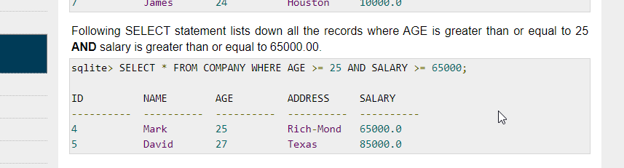
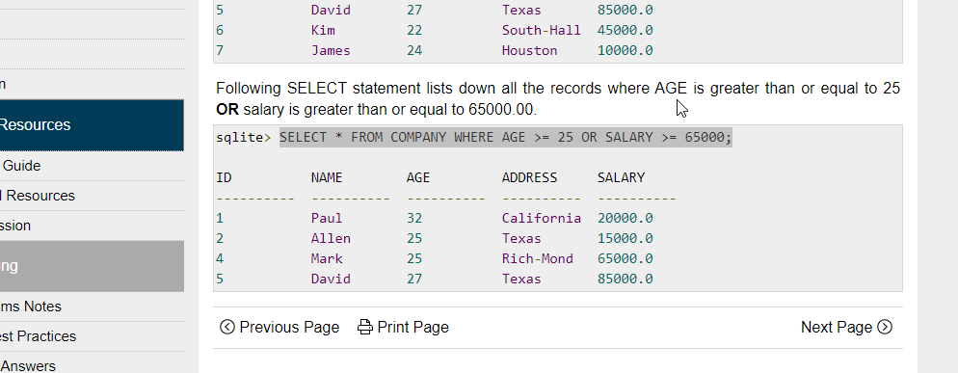
AND & OR operators are used to compile multiple conditions to narrow down the selected data in an SQL statement. These two operators are called conjunctive operators.
The AND operator allows the existence of multiple conditions in a SQLite statement's WHERE clause. [condition1] AND [condition2] will be true only when both condition1 and condition2 are true.
The OR operator is also used to combine multiple conditions in a SQL statement's WHERE clause. [condition1] OR [condition2] will be true if either condition1 or condition2 is true.
SELECT column1, column2, columnN FROM table_name WHERE [condition1] AND [condition2]...AND [conditionN];
SELECT * FROM COMPANY WHERE AGE >= 25 AND SALARY >= 65000;
SELECT column1, column2, columnN FROM table_name WHERE [condition1] OR [condition2]...OR [conditionN]
SELECT * FROM COMPANY WHERE AGE >= 25 OR SALARY >= 65000;

Slide 57
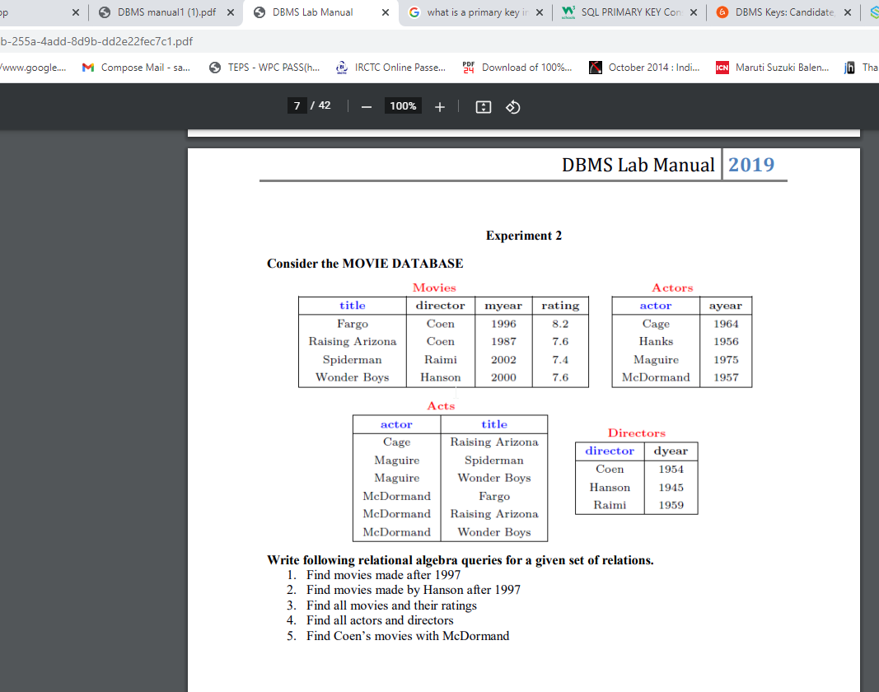
Create the following tables

Slide 58
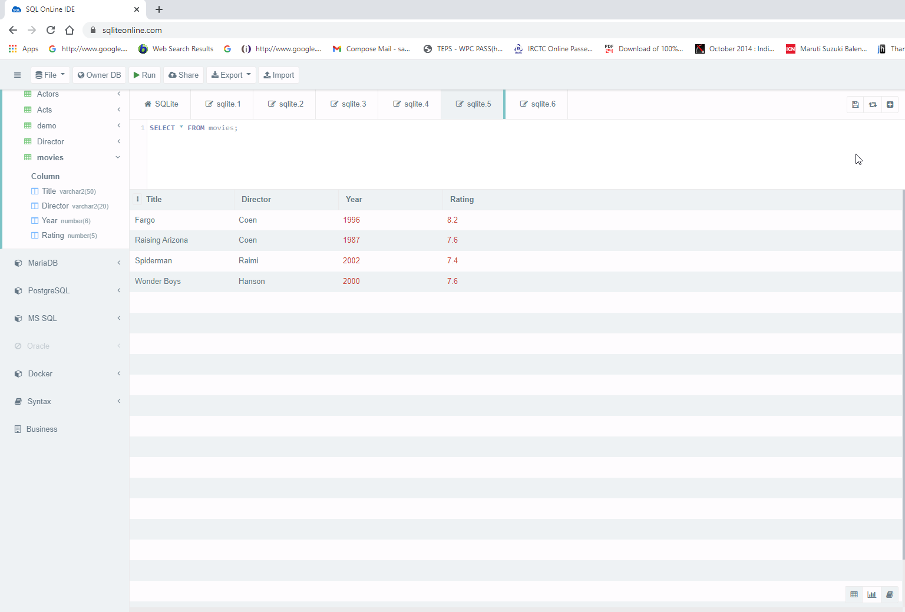
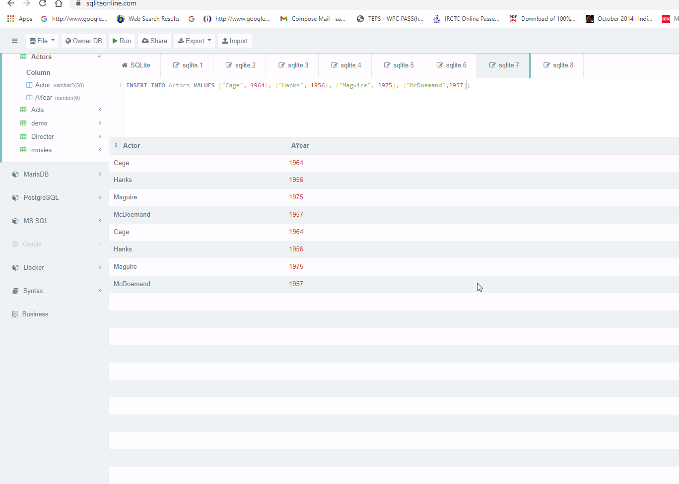
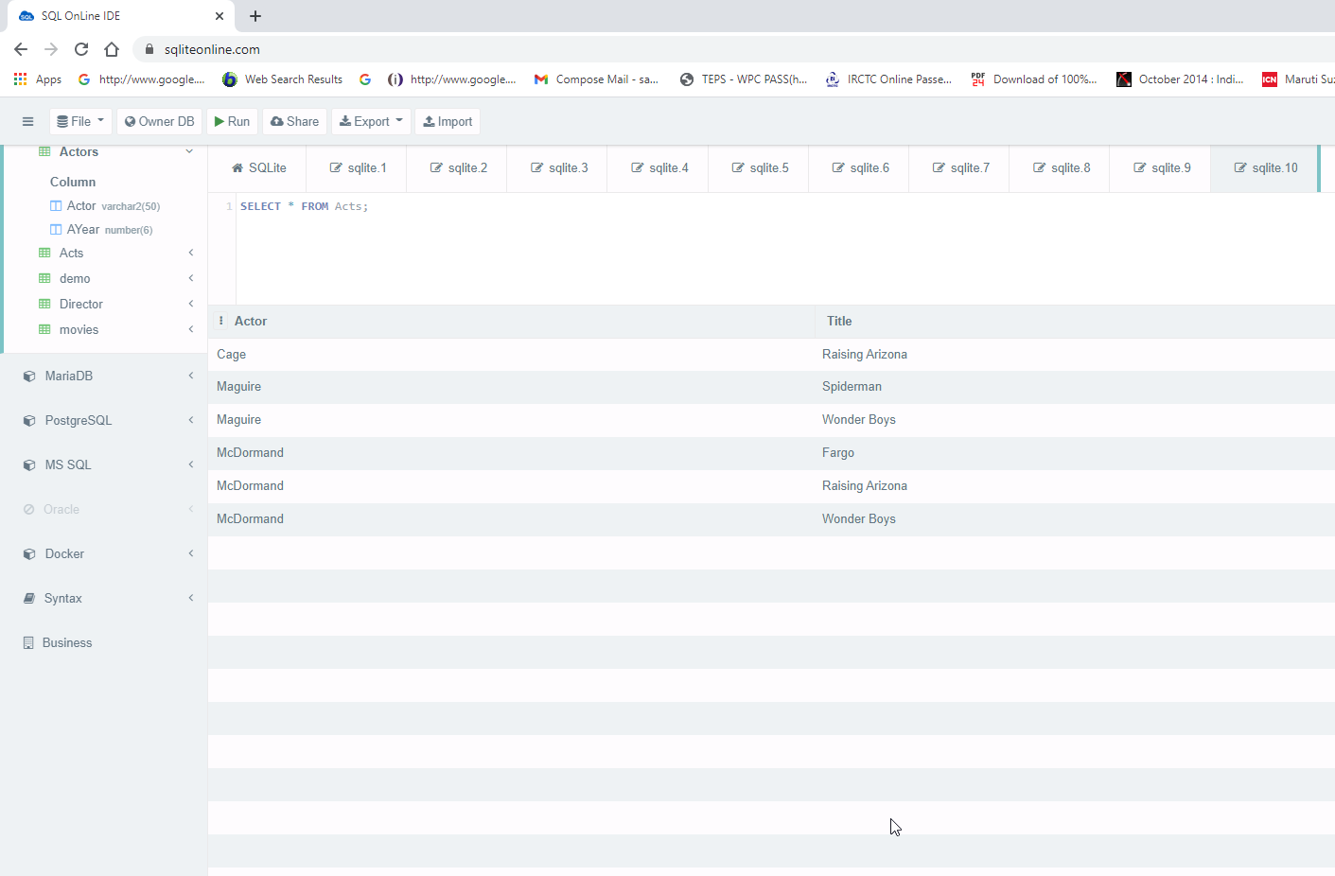
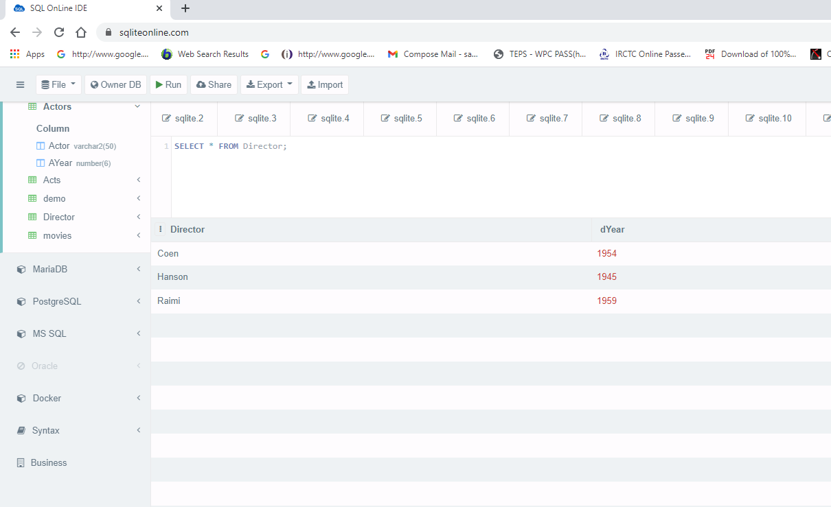

Slide 59
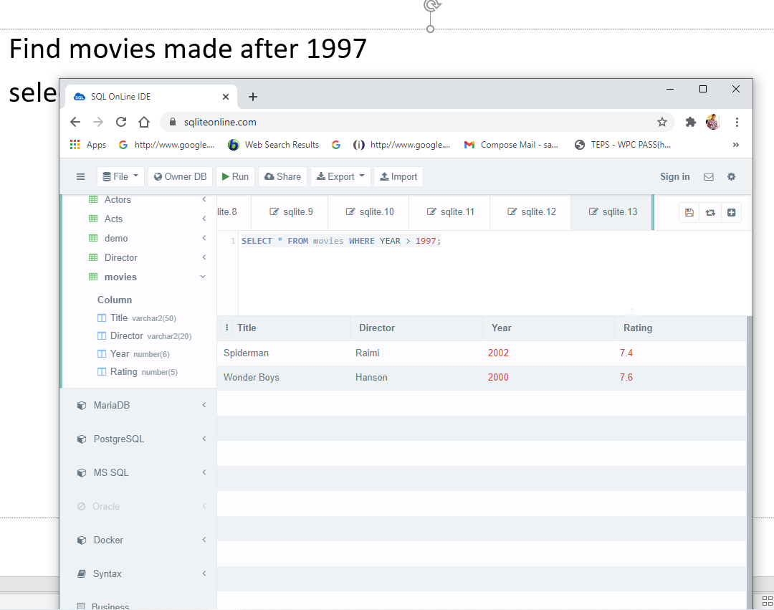
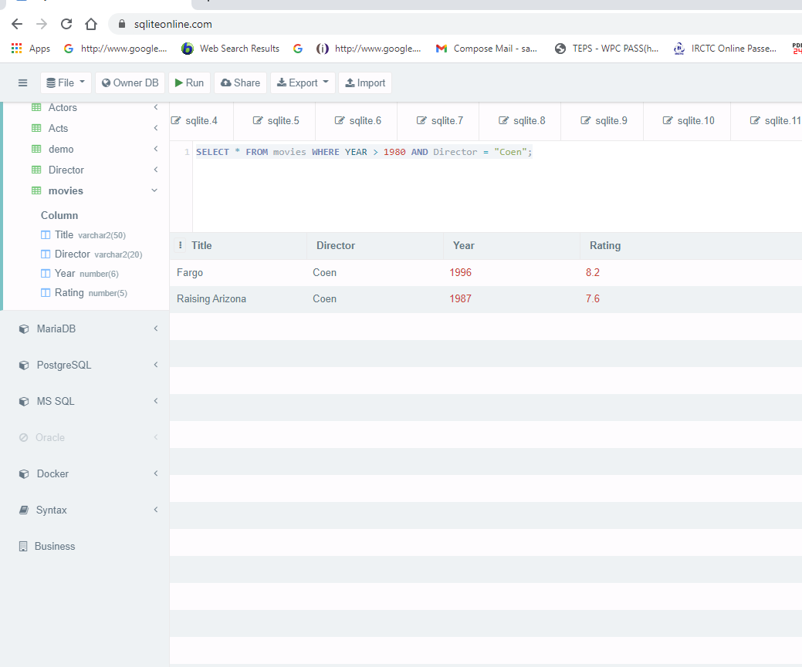
1. Find movies made after 1997
select * from movies where year > 1997;
2. Find movies made by Coen after 1980
select * FROM movies where year > 1980 and Director = "Coen";

Slide 60
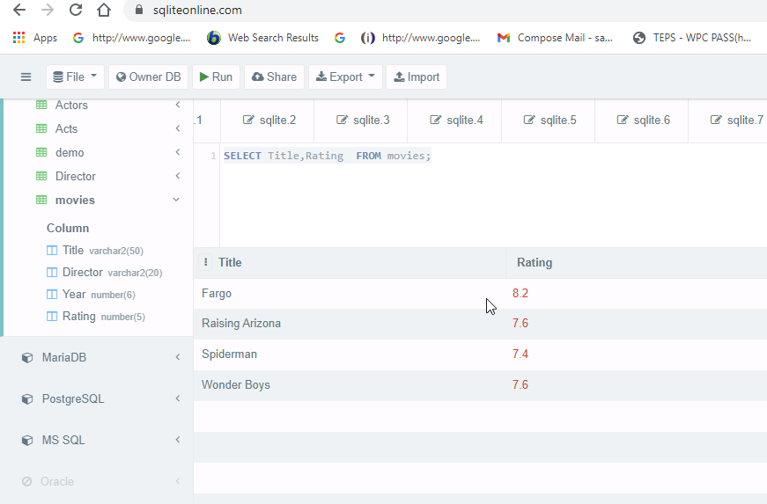
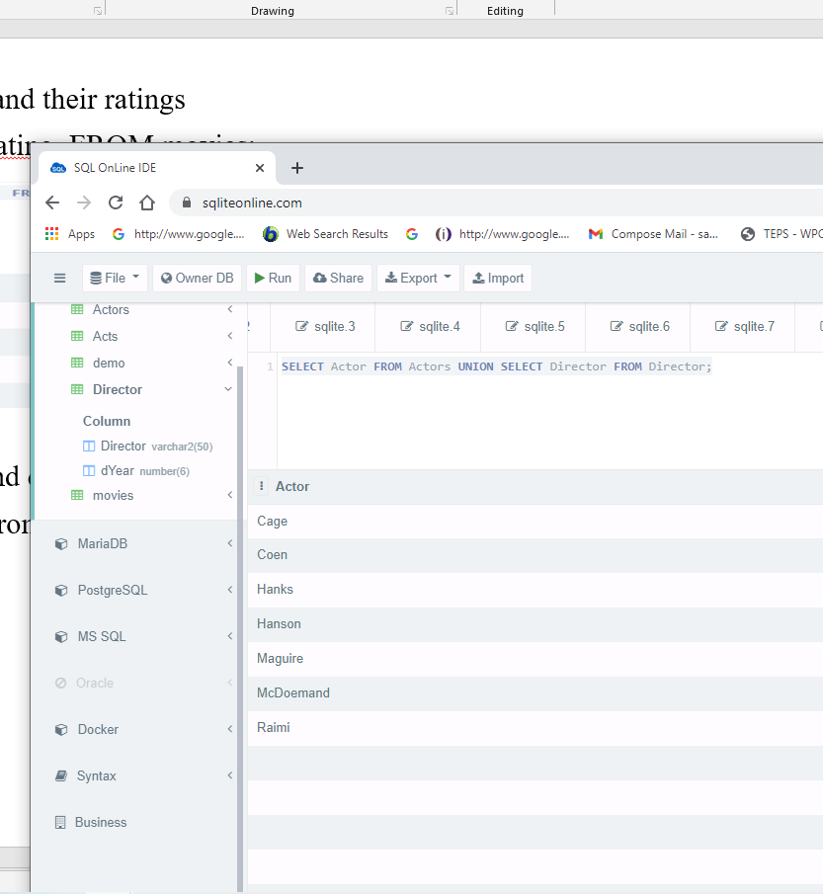
3. Find all movies and their ratings
SELECT Title,Rating FROM movies;
4. Find all actors and directors
SELECT Actor from Actors UNION SELECT Director from Director;

Slide 61
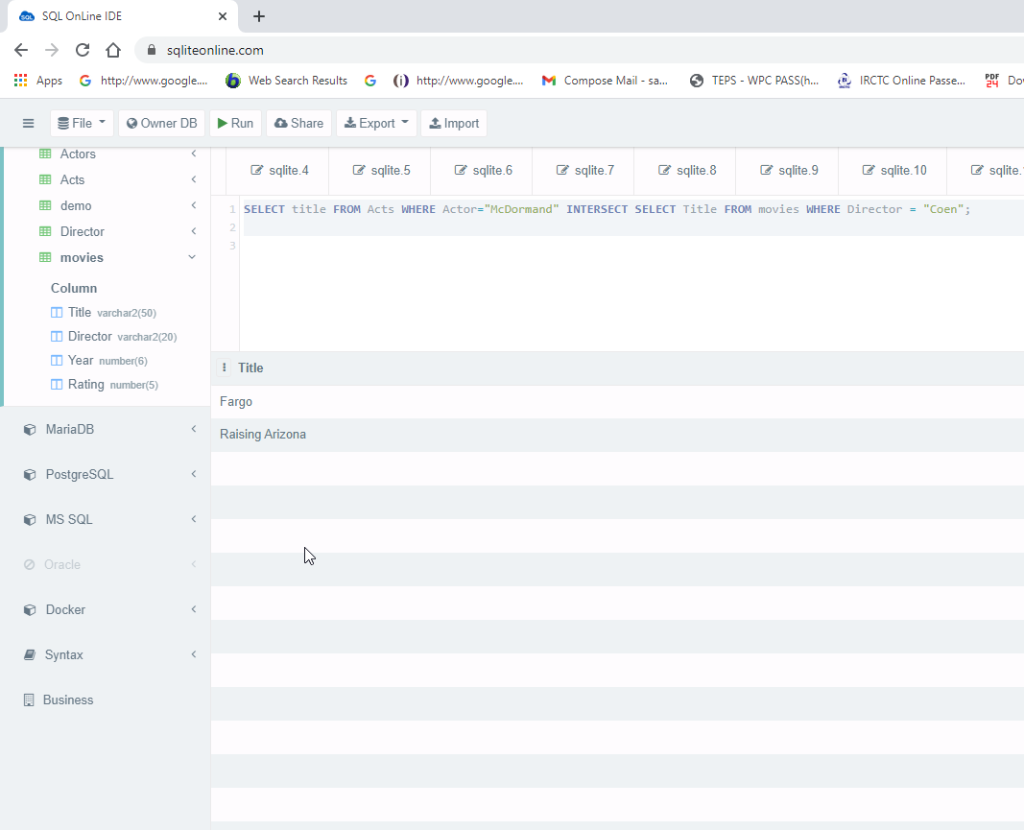
5. Find Coen’s movies with McDormand
SELECT Title from Acts WHERE Actor="McDormand" INTERSECT SELECT Title from movies WHERE Director = "Coen";

Slide 62
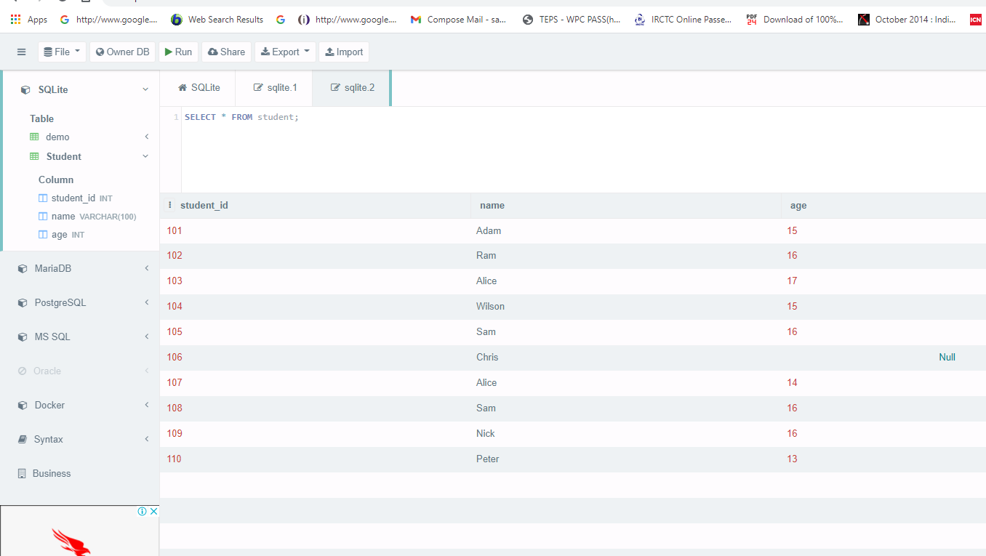
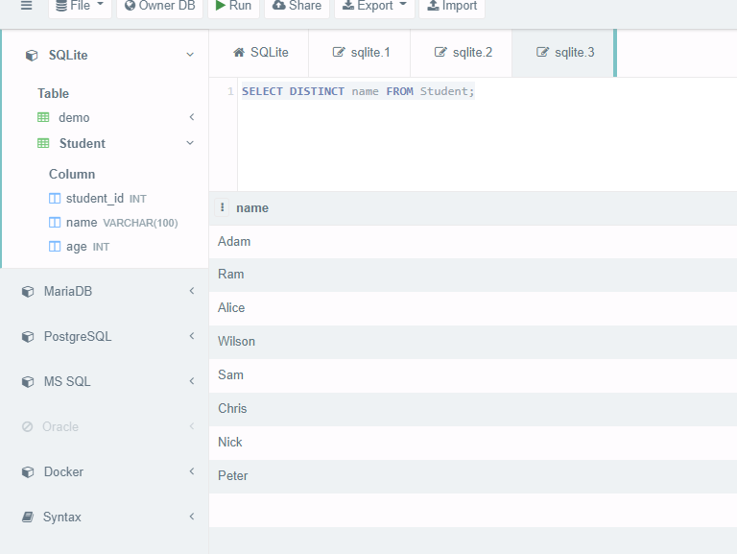
Distinct
The SELECT DISTINCT statement is used to return only distinct (different) values.
Inside a table, a column often contains many duplicate values; and sometimes you only want to list the different (distinct) values.
SELECT DISTINCT column1, column2, ... FROM table_name;
SELECT DISTINCT name from Student;

Slide 63
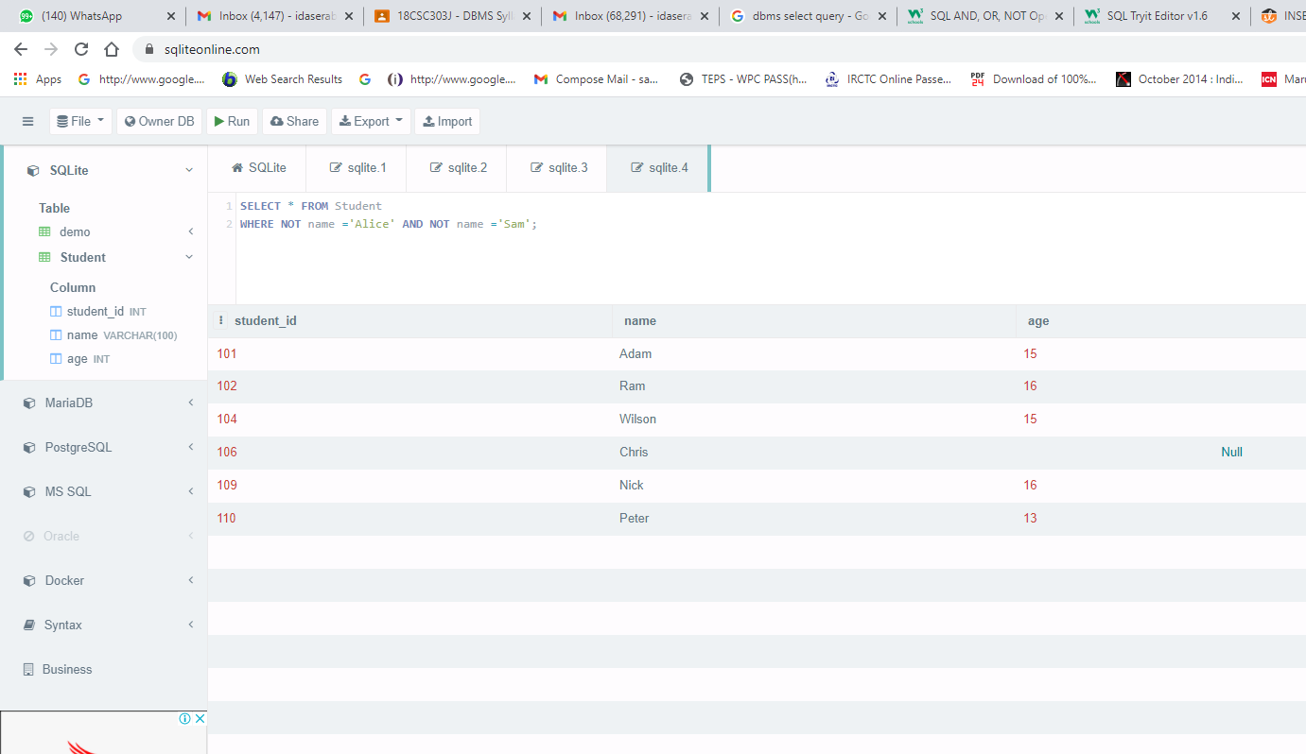
Not Operator
The NOT operator displays a record if the condition(s) is NOT TRUE.
SELECT column1, column2, ... FROM table_name WHERE NOT condition;
SELECT * FROM Student WHERE NOT name ='Alice' AND NOT name ='Sam';

Slide 64
NULL Value
A field with a NULL value is a field with no value.
If a field in a table is optional, it is possible to insert a new record or update a record without adding a value to this field. Then, the field will be saved with a NULL value.
A NULL value is different from a zero value or a field that contains spaces. A field with a NULL value is one that has been left blank during record creation.
It is not possible to test for NULL values with comparison operators, such as =, <, or <>.
Have to use the IS NULL and IS NOT NULL operators instead.
IS NULL Syntax
SELECT column_names FROM table_name WHERE column_name IS NULL;
IS NOT NULL Syntax
SELECT column_names FROM table_name WHERE column_name IS NOT NULL;

Slide 65
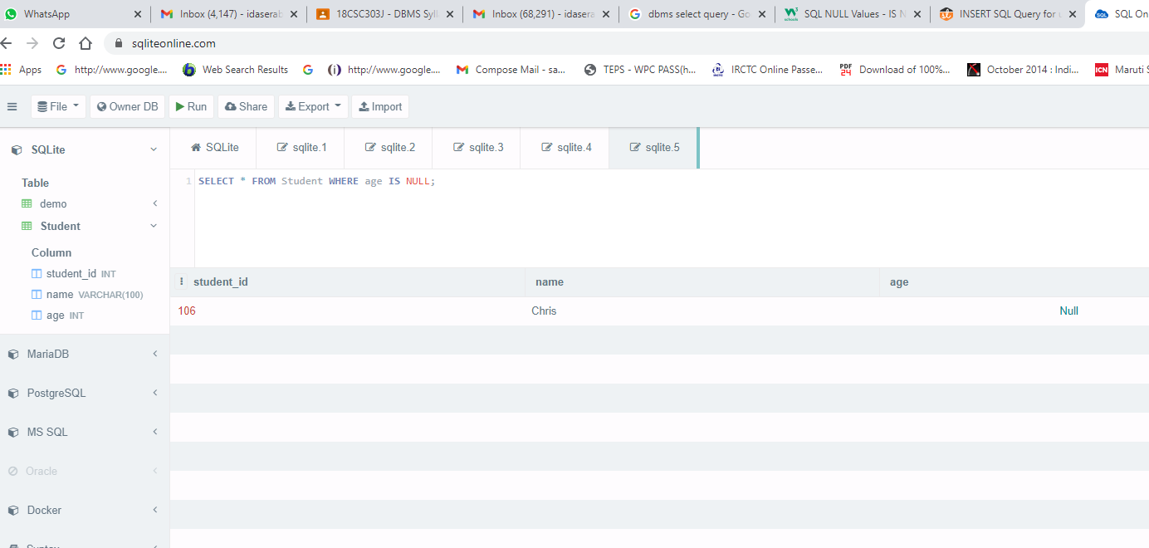
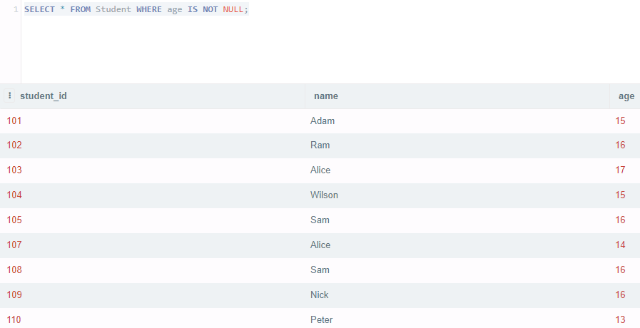
SELECT * FROM Student WHERE age IS NULL;
SELECT * FROM Student WHERE age IS NOT NULL;

Slide 66
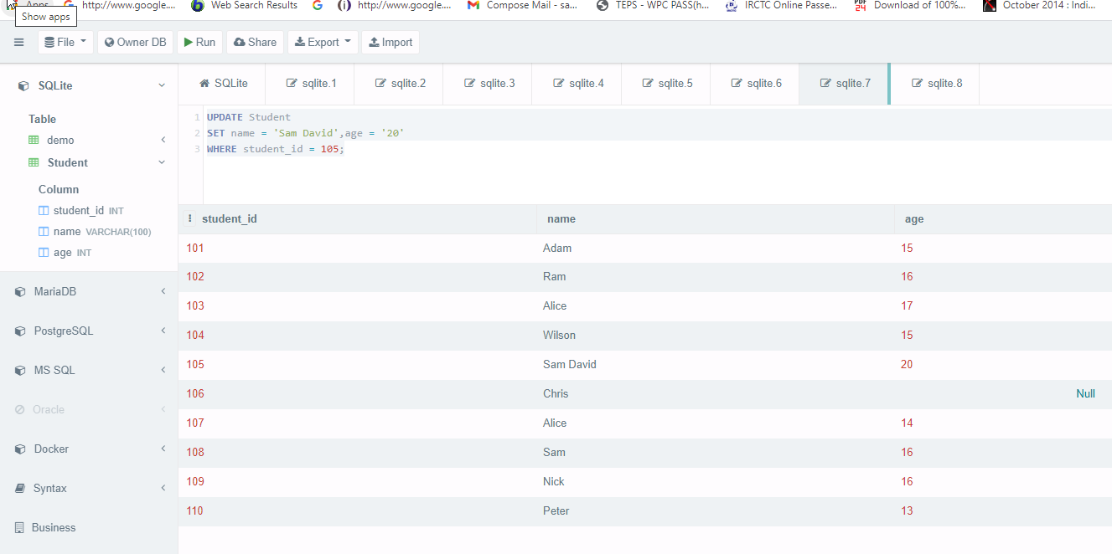
Update
The UPDATE statement is used to modify the existing records in a table.
UPDATE table_name SET column1 = value1, column2 = value2, ... WHERE condition;
UPDATE Student SET name = 'Sam David',age = '20’ WHERE student_id = 105;

Slide 67
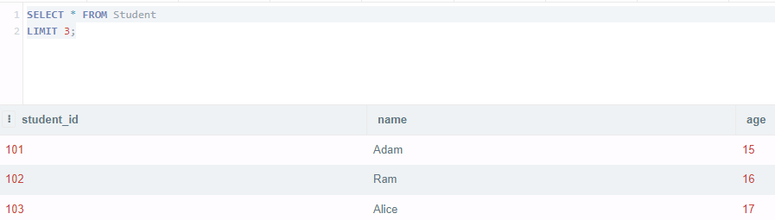
TOP, LIMIT or ROWNUM Clause
The SELECT TOP clause is used to specify the number of records to return.
The SELECT TOP clause is useful on large tables with thousands of records. Returning a large number of records can impact performance.
Not all database systems support the SELECT TOP clause. MySQL supports the LIMIT clause to select a limited number of records, while Oracle uses ROWNUM.
https://www.w3schools.com/sql/sql_top.asp
SELECT * FROM Student LIMIT 3;

Slide 68
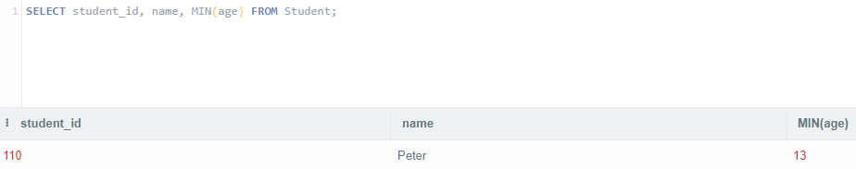
MIN() and MAX() Functions
The MIN() function returns the smallest value of the selected column.
The MAX() function returns the largest value of the selected column.
MIN() Syntax
SELECT MIN(column_name) FROM table_name WHERE condition;
MAX() Syntax
SELECT MAX(column_name) FROM table_name WHERE condition;
SELECT student_id, name, MIN(age) FROM Student;

Slide 69
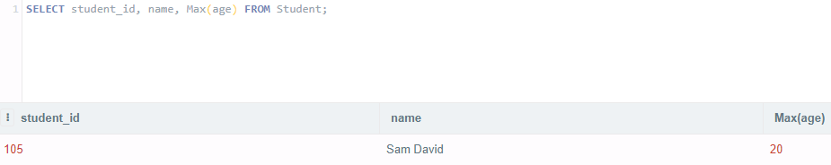
MAX() Functions
SELECT student_id, name, Max(age) FROM Student;

Slide 70
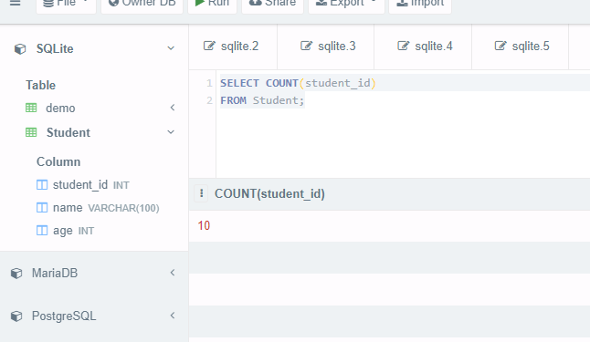
COUNT(), AVG() and SUM() Functions
The COUNT() function returns the number of rows that matches a specified criterion.
The AVG() function returns the average value of a numeric column.
The SUM() function returns the total sum of a numeric column.
COUNT() Syntax
SELECT COUNT(column_name) FROM table_name WHERE condition;
AVG() Syntax
SELECT AVG(column_name) FROM table_name WHERE condition;
SUM() Syntax
SELECT SUM(column_name) FROM table_name WHERE condition;
SELECT COUNT(student_id) FROM Student;

Slide 71
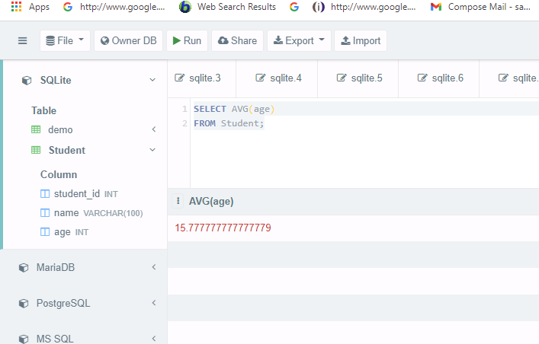
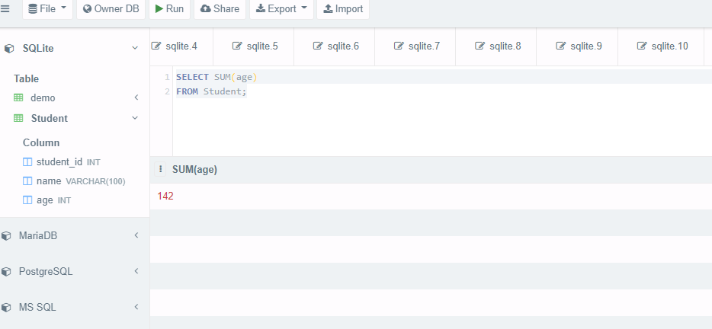
SELECT AVG(age) FROM Student;
SELECT SUM(age) FROM Student;

Slide 72
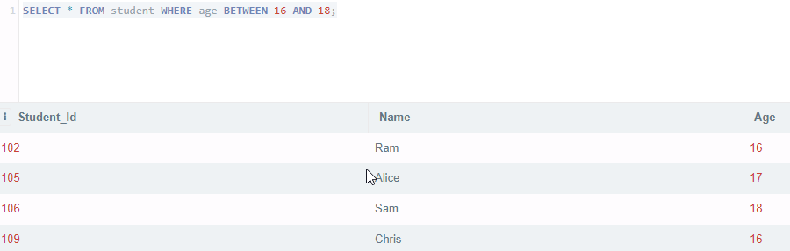
BETWEEN Operator
The BETWEEN operator selects values within a given range. The values can be numbers, text, or dates.
The BETWEEN operator is inclusive: begin and end values are included.
BETWEEN Syntax
SELECT column_name(s) FROM table_name WHERE column_name BETWEEN value1 AND value2;
SELECT * FROM student WHERE age BETWEEN 16 AND 18;

Slide 73
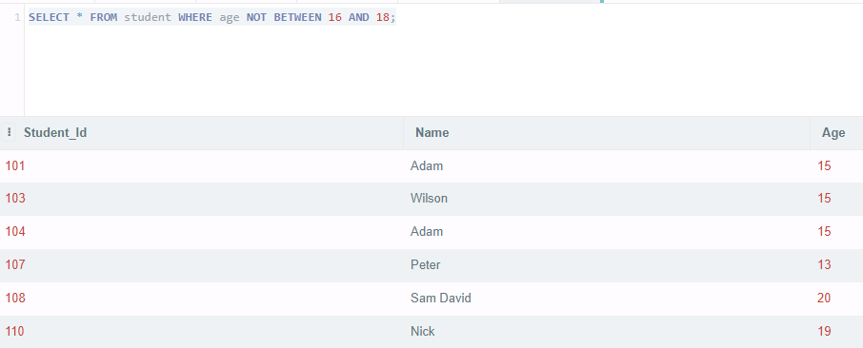
NOT BETWEEN Operator
To display the products outside the range of the previous example, use NOT BETWEEN.
SELECT * FROM student WHERE age NOT BETWEEN 16 AND 18;

Slide 74
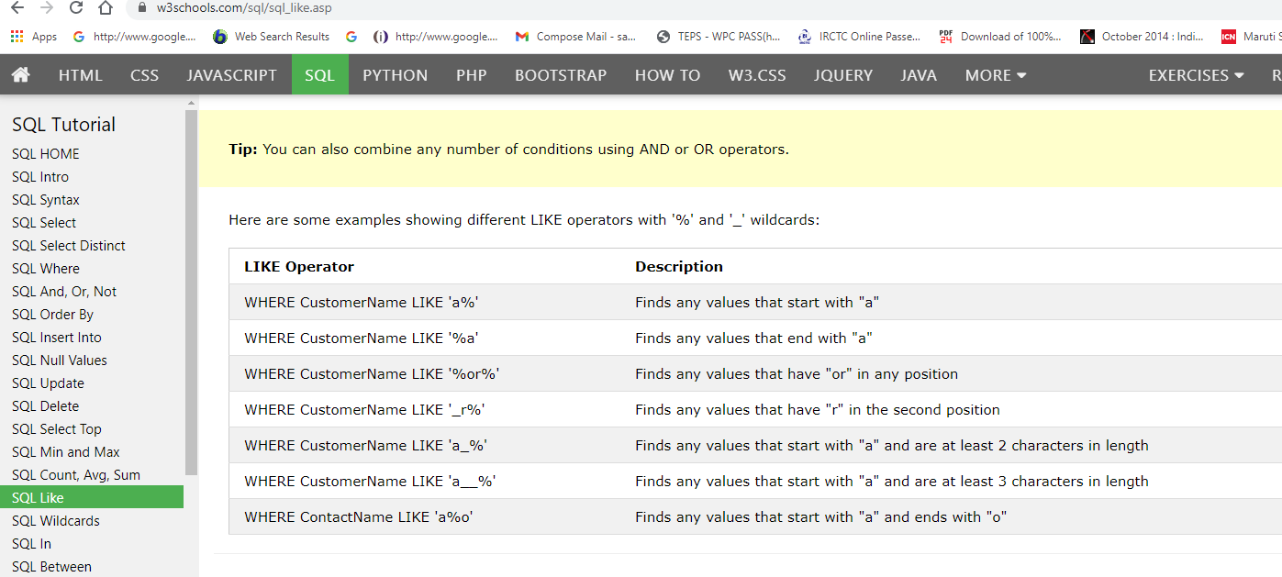
LIKE Operator
The LIKE operator is used in a WHERE clause to search for a specified pattern in a column.
There are two wildcards often used in conjunction with the LIKE operator:
% - The percent sign represents zero, one, or multiple characters.
_ - The underscore represents a single character.
LIKE Syntax
SELECT column1, column2, ... FROM table_name WHERE columnN LIKE pattern;

Slide 75


LIKE Operator
SELECT * FROM student WHERE Name LIKE 'S%’;
SELECT * FROM student WHERE Name LIKE '%m’;

Slide 76

Aliases
SQL aliases are used to give a table, or a column in a table, a temporary name.
Aliases are often used to make column names more readable.
An alias only exists for the duration of the query.
Alias Column Syntax
SELECT column_name AS alias_name FROM table_name;
SELECT Student_Id AS ID, Name AS StudentName FROM student;

Slide 77
Alias for Tables
selects all the orders from the customer with CustomerID=4 (Around the Horn).
We use the "Customers" and "Orders" tables, and give them the table aliases of "c" and "o" respectively (Here we use aliases to make the SQL shorter).
SELECT o.OrderID, o.OrderDate, c.CustomerName FROM Customers AS c, Orders AS o WHERE c.CustomerName='Around the Horn' AND c.CustomerID=o.CustomerID;
Without using Alias
SELECT Orders.OrderID, Orders.OrderDate, Customers.CustomerName FROM Customers, Orders
WHERE Customers.CustomerName='Around the Horn' AND Customers.CustomerID=Orders.CustomerID;

Slide 78
CASE Statement
The CASE statement goes through conditions and returns a value when the first condition is met (like an IF-THEN-ELSE statement).
So, once a condition is true, it will stop reading and return the result.
If no conditions are true, it returns the value in the ELSE clause.
If there is no ELSE part and no conditions are true, it returns NULL.
CASE Syntax
CASE
WHEN condition1 THEN result1
WHEN condition2 THEN result2
WHEN conditionN THEN result
ELSE result
END;

Slide 79


CASE Statement
SELECT orderid, quantity,
CASE
WHEN quantity > 30 THEN 'The quantity is greater than 30’
WHEN quantity = 30 THEN 'The quantity is 30’
ELSE 'The quantity is under 30’
END AS QuantityText
FROM orderdetails;

Slide 80


DELETE Statement
The DELETE statement is used to delete existing records in a table.
DELETE Syntax
DELETE FROM table_name WHERE condition;
DELETE FROM orderdetails WHERE productid = 12;

Slide 81

Delete All Records
It is possible to delete all rows in a table without deleting the table. This means that the table structure, attributes, and indexes will be intact.
DELETE FROM table_name;
DELETE FROM orderdetails;

Slide 82

Different Types of SQL JOINs
(INNER) JOIN: Returns records that have matching values in both tables.
LEFT (OUTER) JOIN: Returns all records from the left table, and the matched records from the right table.
RIGHT (OUTER) JOIN: Returns all records from the right table, and the matched records from the left table.
FULL (OUTER) JOIN: Returns all records when there is a match in either left or right table.

Slide 83



JOIN
The SQL JOIN command is used to combine data from two tables in SQL. The JOIN clause is often used when tables have at least one column of data in common.
A JOIN clause is used to combine rows from two or more tables, based on a related column between them.
Orders Table Customer Table
Order id customerid orderdate
SELECT Orders.OrderID, Customers.CustomerName, Orders.OrderDate FROM Orders INNER JOIN Customers ON Orders.CustomerID=Customers.CustomerID;

Slide 84



LEFT JOIN
The LEFT JOIN keyword returns all records from the left table (table1), and the matched records from the right table (table2). The result is NULL from the right side, if there is no match.
SELECT column_name(s) FROM table1 LEFT JOIN table2 ON table1.column_name = table2.column_name;
customer table order table
SELECT customers.customer_id, orders.order_id, orders.order_date FROM customers LEFT JOIN orders ON customers.customer_id = orders.customer_id ORDER BY customers.customer_id;

Slide 85

RIGHT JOIN
The RIGHT JOIN keyword returns all records from the right table (table2), and the matched records from the left table (table1). The result is NULL from the left side, when there is no match.
SELECT column_name(s) FROM table1 RIGHT JOIN table2 ON table1.column_name = table2.column_name;
orders table customers table
SELECT customers.customer_id, orders.order_id, orders.order_date FROM customers RIGHT JOIN orders ON customers.customer_id = orders.customer_id ORDER BY customers.customer_id;

Slide 86

FULL OUTER JOIN
The FULL OUTER JOIN keyword returns all records when there is a match in left (table1) or right (table2) table records.
SELECT column_name(s) FROM table1 FULL OUTER JOIN table2 ON table1.column_name = table2.column_name WHERE condition;
Order table Customer table
SELECT customers.customer_id, orders.order_id, orders.order_date FROM customers FULL OUTER JOIN orders ON customers.customer_id = orders.customer_id ORDER BY customers.customer_id;

Slide 87
Choose th equery that matches the above image.
A.
Select [List]
from [Table A] A
inner join
[Table B] B
on A.value=B.value
B.
Select [List]
from [Table A] A
full outer join
[Table B] B
on A.value=B.value
where A.value is null
or B.value is null
C.
Select [List]
from [Table A] A
right join
[Table B] B
on A.value=B.value
where A.value is null

Slide 88




Slide 89
Query???
SELECT * FROM employees JOIN departments ON employees.department_id = departments.department_id;
The ON condition indicates how the two tables (the one after FROM and the one after JOIN) should be combined. You can see in the example above that both tables contain the column department_id. The SQL query will return rows where the employees.department_id is equal to the departments.department_id.

Slide 90
Aliases
SELECT employees.department_id AS ID, employee_name AS ‘Employee Name’, department_name AS Department FROM employees JOIN departments ON employees.department_id = departments.department_id;
Example for using

Slide 91

This is an example for Right join??? T/F
SELECT * FROM employees emp LEFT JOIN departments dep ON emp.department_id = dep.department_id;

Slide 92

This is an example for Right join??? T/F

Slide 93

Give the query for this output??

Slide 94
SELF JOINS
A self join is a regular join, but the table is joined with itself.
SELECT column_name(s) FROM table1 T1, table1 T2 WHERE condition;
T1 and T2 are different table aliases for the same table.
EXAMPLE
SELECT A.CustomerName AS CustomerName1, B.CustomerName AS CustomerName2, A.City FROM Customers A, Customers B WHERE A.CustomerID <> B.CustomerID AND A.City = B.City ORDER BY A.City;
The ABOVE SQL statement matches customers that are from the same city:

Slide 95
TCL -Transaction Control Languages
TCL stands for Transaction Control Languages. These commands are used for maintaining consistency of the database and for the management of transactions made by the DML commands.
A Transaction is a set of SQL statements that are executed on the data stored in DBMS.
Whenever any transaction is made these transactions are temporarily happen in database. So, to make the changes permanent, we use TCL commands.
The TCL commands are
COMMIT
ROLLBACK
SAVEPOINT

Slide 96


COMMIT
This command is used to save the data permanently.
Whenever we perform any of the DDL command like -INSERT, DELETE or UPDATE, these can be rollback if the data is not stored permanently.
So in order to be at the safer side COMMIT command is used.
Syntax
commit;

Slide 97

ROLLBACK
This command is used to get the data or restore the data to the last save point or last committed state.
If due to some reasons the data inserted, deleted or updated is not correct, you can rollback the data to a particular save point or if save point is not done, then to the last committed state.
Syntax
rollback;

Slide 98



SAVEPOINT
This command is used to save the data at a particular point temporarily, so that whenever needed can be rollback to that particular point.
Syntax
Savepoint A;

Slide 99
DCL - Data Control Language
DCL stands for Data Control Language in Structured Query Language (SQL). As the name suggests these commands are used to control privilege in the database.
The privileges (Right to access the data) are required for performing all the database operations like creating tables, views, or sequences.
DCL command is a statement that is used to perform the work related to the rights, permissions, and other control of the database system.
There are two types of Privileges in database
System Privilege
Object Privilege

Slide 100
Commands in DCL
The two most important DCL commands are
GRANT
REVOKE
GRANT
This command is used to grant permission to the user to perform a particular operation on a particular object.
If you are a database administrator and you want to restrict user accessibility such as one who only views the data or may only update the data. You can give the privilege permission to the users.
Syntax
GRANT privilege_list ON Object_name TO user_name;
REVOKE
This command is used to take permission/access back from the user. If you want to return permission from the database that you have granted to the users at that time you need to run REVOKE command.
Syntax
REVOKE privilege_list ON object_name FROM user_name;

Slide 101
Following commands are granted to the user as a Privilege List
EXECUTE
UPDATE
SELECT
DELETE
ALTER
ALL
Advantages Of DCL commands
It allows to restrict the user from accessing data in database.
It ensures security in database when the data is exposed to multiple users.
It is the wholesome responsibility of the data owner or data administrator to maintain the authority of grant and revoke privileges to the users preventing any threat to data.
It prevents other users to make changes in database who have no access to Database

